Slide 1




Cover Slide
Good Planning, Better Survey Data
Introduction into Web Survey Design
CONTACT
Dr. Susanne de Vogel
Data Scientist | Help-desk
devogel@uni-bremen.de
dsc-ub.de
1
02 June 2025 ▪ DSC-Training
Notes:
Good morning everyone, and welcome to the workshop on web survey design. I am happy to have you here and hope you are all doing well.

Slide 2










Schedule for Today
09:30 | Welcome and Introduction | 13:00 | Participant Motivation and Incentivization
10:00 | Introduction to Web Surveys | 13:45 | Data Protection
10:30 | Coffee Break | 14:15 | Coffee Break
10:45 | Sampling in Web Surveys | 14:30 | Documentation
11:20 | Participant Recruitment | 15:00 | Getting Started
11:50 | Participant Motivation and Incentivization | 15:15 | Wrap Up
12:00 | Lunch Break
Notes:
In the next couple of hours, I want to give you a basic crash course in web survey design. The workshop is divided into several sections, with two coffe breaks and a one hour lunch break around 12.
Here’s our plan for the day! We’ll start with a quick welcome and introduction, then dive into the basics of web surveys—what they are and why we use them. Next, we’ll cover sampling, or how to decide who you want to reach, followed by some strategies for recruiting participants to actually take the survey.
Then, we’ll focus on keeping participants motivated and incentives to minimize nonresponse and drop-out rates. Then, we’ll look at data protection and ethics—super important for handling personal data responsibly. We’ll finish with a section on documentation, which keeps your research clear and organized for you and others.
And finally, we’ll wrap up with how to get started and some further resources.
Given our limited time, I’m focusing on providing the basic input here, with additional resources to help you continue learning independently. I see some familiar faces here already since some of you were already in the workshop on questionnaire design. As some topics might overlap with questionnaire design, there will be a few repetitions, but I am sure you will still learn something new today.
We’ll have some interactive moments, but we won’t be doing hands-on exercises or working on your specific topics. For that, I encourage you to reach out afterward—I’d be happy to meet for individual consultations on whatever you need in your web survey design.

Slide 3
Introduction
Housekeeping
Have your phones ready.
Slides will be shared at the end.
Certificates will be sent after the training
Questions welcome ☺
There are no stupid questions – this is (hopefully) a safe space!
Notes:
Feel free to ask questions at any time. I planned plenty of time for questions and will always provide space for discussions at certain points in between. I suggest to either write questions in the chat or just raise your hand. While I am talking, I wont always be able to see your questions immediately, but I will do my best to address them as soon as possible.
I ask you to have your phones ready as there will be some interactive parts.
Slides from today’s workshop will be shared with you at the end, so you don’t need to worry about taking extensive notes.
And there will of course be attendance certificates. We need some time to prepare them, so they will be emailed to you at the end of our training.

Slide 4




Who am I?
Susanne de Vogel (she/her)
Social Scientist
Diploma in Social Sciences (2013), University of Cologne and Utrecht University
PhD in Sociology (2019), Martin-Luther-University Halle-Wittenberg
Research Associate at DZHW German Centre for Higher Education Research and Science Studies (2013-2020), Hannover
National Academics Panel Study (Nacaps) and PhD Graduate Panel; survey design, panel data analysis, research data management
Research on educational inequalities, early career researchers, academia
Since May 2024 Data Scientist at the Data Science Center
Training and consulting for researchers
Data science and research data management
Notes:
Now I want to first tell you a little bit more about me and my background:
My name is Susanne and my pronouns are she/her.
I am a sociologist by training
I work as a Data Scientist at the data science center at the university of Bremen and provide trainings and help-desk support for the Social Sciences.
Prior to this role, I was a research associate at DZHW Hannover for around ten years. During my time there, I built up several panel studies like the PhD Panel Study, also known as the DZHW-Promoviertenpanel, and the National Academics Panel Study (Nacaps). I was involved in study design, questionnaire designing and testing, conducting the surveys, data cleaning, analysing and also managing the survey data – basically all activities along the research life cycle.
In this workshop, I am going to use examples of these studies quite a lot – as good examples, but also as example to demonstrate where we really screwed up. So I thought I’d quickly share a bit about the two projects I’ve worked on.

Slide 5
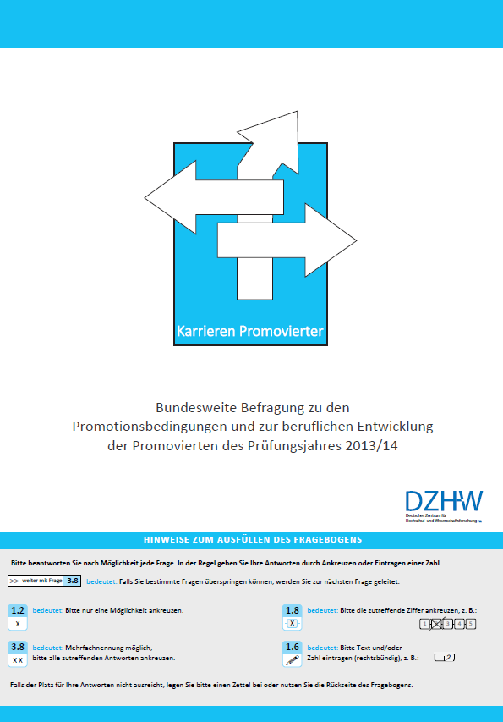
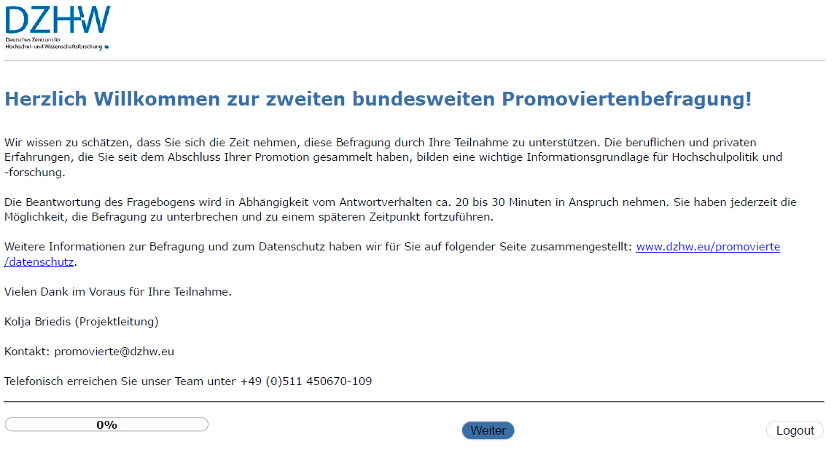
Who am I?
PhD Panel Study (Promoviertenpanel)
Project duration: September 2013 – March 2024 (funded by BMBF)
Target population: census survey
All persons who completed a doctorate at a German HEI in 2014 (N=28,147)
All formal contexts and subjects
Initial sample size n=5,408 (response rate 27%); follow-ups ca. n=3,000
Survey design: longitudinal study
Initial wave about one year after graduation, paper-pencil
Nine annual follow-up surveys, online
German Centre for Higher Education Research and Science Studies (2024). DZHW PhD Panel 2014 - Survey 1. Data collection: 2015. Hanover: FDZ-DZHW.10.21249/DZHW:phd2014:4.0.0. Questionnaire “Karrieren Promovierter” (1st wave - German)". Cover page.
German Centre for Higher Education Research and Science Studies (2024). DZHW PhD Panel 2014 - Survey 2. Data collection: 2016. Hanover: FDZ-DZHW.10.21249/DZHW:phd2014:4.0.0. Questionnaire “Karrieren Promovierter” (2nd^{t} wave - German)". Cover page.
Notes:
The first one is the PhD Panel Study, or ‘Promoviertenpanel,’ which has been running for 10 years since 2013 and was funded by the BMBF.
The study was concepted as a full sample survey and targeted everyone who completed a doctorate at a German higher education institution in 2014, covering all fields and formal contexts.
It was a multitopic survey focussing mainly on the experience during doctoral phase and their subsequent career trajectories, but we inquired information about their personal life situation, personality traits and focus topics like COVID-19.
The design here is longitudinal, meaning we followed participants over time. We started with a paper-pencil survey roughly a year after their graduation, and then we switched to annual online follow-up surveys. In total, we realized 10 surveys.

Slide 6
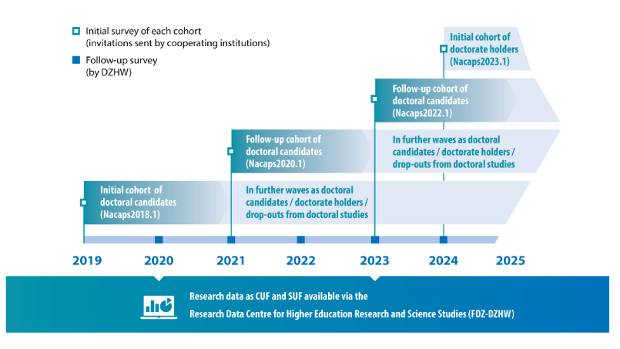
Who am I?
National Academics Panel Study (Nacaps)
Project duration: Januar 2017 – ongoing (funded by BMBF)
Target population: census survey
All persons who started/completed a doctorate at a German HEI
66 participating universities
Survey design: multicohort longitudinal study
Initial wave about one year after starting/graduating PhD
annual follow-up surveys
New cohort every other year (doctoral candidates since 2018; doctorate holders since 2024)
online
German Centre for Higher Education Research and Science Studies (DZHW) (2018). Nacaps study design – survey logic. Retrieved June 25, 2025, from https://www.nacaps.de/en/studie/index_html#studiendesign. Used with permission for educational purposes as stated on the website.
Notes:
The second project I’ve been involved with— Nacaps – is a multicohort longitudinal study, which has been ongoing since 2017, also funded by the BMBF.
This survey targets all individuals who either started or completed their doctorate at a German higher education institution. So far, there were 66 cooperating universities.
The design here is a bit different from a single-cohort study; we’re using a multicohort approach, where we add a new cohort every two years. This means that since 2018, we’ve been following both doctoral candidates and, more recently, doctorate holders, adding another layer of complexity to the study. Each cohort starts with an initial survey about a year after they begin or complete their doctorate, followed by annual online follow-ups.
Topics are similar like the PhD Graduate Panel study, but with a rather bigger focus on the experience during the doctorate.
I also found it nice, since their topics are relatable to all of you, regardless of your different backgrounds.

Slide 7

Who are You?
Brief round of introductions
Name (pronouns)
Institution
Discipline
Image generated with DALL·E (June 2025).
Notes:
Which leads me to my next question. I would like to ask you to briefly introduce yourselves.
Please go around and state your name, your institution and the discipline you’re coming from. But please keep it very brief.
I would also appreciate if you could turn on your camera for this if your comfortable with it. It’s always nice to have a face in mind when talking to you.

Slide 8
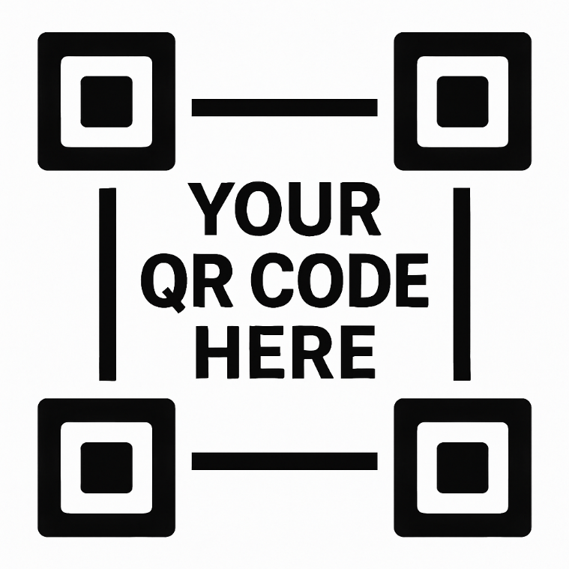
Who are You?
Web Survey!
Visit
www.menti.com
Enter code
Image generated with DALL·E (June 2025).
Notes:
Before we look into the content, I’d like to get a quick sense of how familiar you are with web surveys, and what you’re hoping to get out of this workshop.
To do that, we’ll start with a short web-based survey
You can access it in three different ways:
You can scan the QR code you see on the screen using your phone,
You can go to www.menti.com and enter the code displayed,
Or, if it’s easier, I’ll paste the direct link in the chat now.
Please take a minute or two to respond to the questions. Your answers will help me tailor the workshop to your experience level and interests.

Slide 9
Introduction to Web Surveys
8
Notes:
Thank you for this very cool introduction round. Nice to meeting you all!
We can now dive into the content, and I will start with a brief introduction to web surveys.

Slide 10














Web Surveys
What is it?
An online survey is a digital questionnaire distributed and completed over the internet.
Self-administered
Accessed on internet-enabled devices, such as computers, tablets, or smartphones
Distributed via a URL, which can be shared through email, social media, or embedded on a website
Responses are automatically recorded in a digital database
Notes:
First of all: What is a web survey? A web survey is essentially a digital questionnaire completed over the internet.
It’s self-administered, so participants fill it out on their own, without an interviewer.
They can access it from any device with internet—whether that’s a computer, tablet, or smartphone.
The survey is distributed via a URL, which can be shared in different ways: email, social media, or embedded directly on a website.
Once completed, responses are automatically recorded in a digital database, making data collection efficient and organized.

Slide 11


Web Surveys
Pros
When useful?
Cost-effective (no need for printed materials, postage, or interviewers)
Created, distributed, and collected quickly
Broad reach
Easier data cleaning and processing
Responses directly entered into the database, no data entry errors
Forcing, plausibility checks and range validation on the fly
Support a variety of question formats, including images, audio, and videos
Convenience for respondents
can complete the survey at their own pace and from any device
Visual conditions and branching
Large, geographical diverse samples
Time-sensitive data collection
Sensitive topics
Anonymity
Studies requiring visual or multimedia content
Follow-up and longitudinal studies
Meme using the Oprah You Get a Car meme template, retrieved from Make a Meme, https://makeameme.org/meme/quantitative-research-survey (accessed 25 June 2025)
Notes:
So, let’s talk about some of the advantages of web surveys and when they’re particularly helpful.
On the left, you can see some of the main pros.
First, they’re very cost-effective—no need to worry about printing, postage, or hiring interviewers. They’re also quick to set up, distribute, and collect data from, making them ideal for time-sensitive studies.
Web surveys can reach a broad audience, even across large or geographically diverse samples.
They’re also great for data cleaning and processing since responses go straight into a database, minimizing entry errors.
Plus, with web surveys, we can include validation checks to guide respondents if they make an input mistake.
There’s also flexibility in terms of question formats—you can use images, audio, and even video if that suits your study.
And importantly, they’re convenient for respondents—they can complete the survey at their own pace, on any device.
Now, when are web surveys particularly useful?
Klick
They’re ideal for reaching large and geographically spread-out samples.
They’re also a good choice if you’re working with time-sensitive data or dealing with sensitive topics, as online surveys can offer a degree of anonymity.
Additionally, if your study requires multimedia elements or involves follow-up waves, web surveys can be very efficient for managing those needs.

Slide 12


Web Surveys
Cons
When problematic?
Restricted to individuals with internet access, which can exclude certain demographics (e.g., older adults, low-income populations, or those in areas with limited internet connectivity)
Technical challenges
Data quality issues
higher risk of erroneous, incomplete, or fraudulent responses
Respondents have a shorter attention span
Shorter questionnaires (max 15 min)
Lower response rates, high drop-out rates
Limited control over respondents environment
Population with limited internet access
Controlled or observational studies
Survey requires extensive explanations, probing questions, or clarification
Meme using the Grandma Finds the Internet template. Created by reddit user phamkethanh, captured via imgflip.com. Retrieved from https://www.reddit.com/r/meme/comments/1763imq/grandma_finds_the_internet/ (accessed 25 June 2025).
Notes:
Now, let’s look at the flip side—some of the downsides of web surveys and when they might not be the best option.
First, access is restricted to individuals with internet, which can exclude certain groups, like older adults or low-income populations who might not have reliable connectivity.
There are also technical challenges, both on the participant's end and in ensuring the survey functions smoothly on different devices.
Data quality can be a concern. With online surveys, there’s often a higher risk of errors, incomplete answers, or even fraudulent responses.
We know from survey research that people have a shorter attention span online, which means questionnaires should ideally stay under 15 minutes to reduce drop-outs.
Another challenge is limited control over the environment. We can’t control where or when participants are completing the survey, which might affect their focus or how they respond.
Klick
On the right, we see some scenarios where online surveys might not work as well.
If you’re targeting a population with limited internet access, or if you’re conducting a controlled study that requires close observation or clarification, online may not be the best fit.
Similarly, if your survey requires detailed explanations or probing, face-to-face methods might be more suitable.

Slide 13

Web Surveys
Types of Web Surveys
Types by timing
Cross-sectional survey
Longitudinal survey
Panel Survey
Cohort Survey
Trend Survey
Notes:
Alright, let’s start with a quick look at the main types of web surveys. Broadly speaking, we can categorize surveys based on their timing.
Klick
Under 'timing,' we have cross-sectional surveys, which capture a snapshot at one point in time, and longitudinal surveys, which track changes over time.
Longitudinal surveys can be further broken down into panel, cohort, and trend surveys, each with its own way of following subjects or topics across time.

Slide 14






Web Surveys
Cross-Sectional Surveys
Data is collected at one point in time, without repeated follow-ups.
Researchers observe and record data without manipulating any variables or introducing interventions.
When useful?
When problematic?
describing the characteristics of a population, such as the prevalence of certain behaviors, conditions, or attitudes
identify potential associations between variables (e.g., the relationship between age and smartphone usage)
analyzing variations across subgroups
No causal conclusion
Findings represent the specific time of data collection
No changes over time
Notes:
Cross-sectional surveys are all about capturing data at a single point in time. Think of it as taking a snapshot—you’re getting a picture of your subjects’ responses as they are right now, without any follow-up or ongoing observation. Researchers just record what’s there without manipulating any variables.
Klick
So, when are cross-sectional surveys useful?
They’re great for describing the characteristics of a population. For example, you can get a sense of how many people in a group hold a certain opinion or engage in a certain behavior.
They’re also helpful for spotting associations between variables, like seeing if there’s a relationship between age and smartphone use.
And if you want to analyze variations across different subgroups, this type of survey is really handy.
Klick
But, there are limitations.
Because it’s just a snapshot, we can’t draw causal conclusions.
We only know that things were a certain way at this point in time, and that’s it—no insight into how or why they might change later.
It’s a fixed picture, not a story over time.

Slide 15





Web Surveys
Longitudinal Surveys
Longitudinal data refer to repetitive measurements over time, often through repeated surveys at regular intervals.
Panel Survey
Cohort Survey
Trend Survey
Follow the same individuals over time
individual behavior and change
Causal relationships
Follow a specific group that shares a defining charac-teristic (e.g., birth year) over time
Live course research
Comparing generational changes
Tracking outcomes of shared experiences
Survey different samples from the same population over time
Population-level trends
Monitoring social and economic indicators
Notes:
Longitudinal surveys are all about tracking change over time. Unlike a cross-sectional survey, which just captures one moment, longitudinal surveys let us see how things evolve. They involve repeated measurements, often through regular follow-ups.
There are three main types of longitudinal surveys:
Klick
Panel Surveys: These follow the same individuals over time. So, if you’re interested in understanding how individual behaviors change, or even finding causal relationships, panel surveys are ideal. By tracking the same people, you can really see how things shift on a personal level.
Klick
Cohort Surveys: Instead of following the same individuals, cohort surveys track a group that shares a common characteristic, like people born in the same year. This is great for research on life events or generational comparisons. You’re looking at a specific group’s experiences as they go through life stages together.
Klick
Trend Surveys: Here, you survey different samples from the same overall population at multiple points in time. This approach helps monitor broader population trends, like public opinion on an issue or economic indicators. Each survey gives you a slice of how the population feels or behaves at that time, without sticking to the same individuals.

Slide 16

Web Surveys
Types of Web Surveys
Types by timing
Types by purpose
Cross-sectional survey
Longitudinal survey
Panel Survey
Cohort Survey
Trend Survey
Exploratory survey
Descriptive survey
Explanatory survey
Notes:
We can also categorize web surveys based on their purpose.
Here we find exploratory surveys, which help us understand new areas; descriptive surveys, which aim to detail characteristics of a population; and explanatory surveys, which dig into the 'why' behind certain patterns.

Slide 17
Web Surveys
Purposes
Survey Type | Purpose | Typical Questions | Example Scenarios
Exploratory | To gather preliminary information (e.g. identifying issues) on a topic or phenomenon when little is known about it. | Is there something happening? | Consumer preferences Health behavior Workplace culture
Descriptive | To systematically describe the topic at hand. | What is happening? | Census data Health statistics
Explanatory | To investigate cause-and-effect relationships by identifying how different variables relate to or influence each other | Why/How does this happen? | Behavioral study Educational research Marketing analysis
Notes:
In terms of survey purpose, we generally see three main types:
Exploratory Surveys: These are used when we’re just starting to learn about a topic. If you don’t know much about an area yet, an exploratory survey helps gather initial insights. Think of it as ‘testing the waters.’ For example, companies might use exploratory surveys to get a sense of consumer preferences or to understand workplace culture.
Descriptive Surveys: These aim to describe what’s happening in a specific area. They systematically capture details about a topic without trying to understand cause and effect. Typical questions revolve around 'What is happening?' For instance, health organizations often use descriptive surveys for things like census data or tracking health statistics.
Explanatory Surveys: Here, the goal is to dig deeper into why or how something happens. These surveys explore relationships between variables and help us understand cause and effect. They’re common in fields like behavioral studies or educational research, where understanding the dynamics between different factors is crucial.

Slide 18
Total Survey Error Framework
Measurement
Representation
Construct
Population Mean
Validity
Coverage Error
Sampling Frame
Measurement
Sampling Error
Measurement Error
Sample
Response
Nonresponse Error
Processing Error
Respondents
Adjustment Error
Edited Response
Postsurvey Adjusted Data
Survey Statistic
Figure adapted from Figure 2.5 in Groves, R.; Fowler, F.; Couper, M.; Lepkowski, J.; Singer, E.; Tourangeau, R. (2009). Survey Methodology (2nd Edition). John Wiley & Sons, Inc. ISBN 0-470-46546-8
Notes:
Alright, let’s talk about the Total Survey Error (TSE) Framework. TSE is a way of understanding all the possible sources of error that can affect survey data, and it helps us see where things might go wrong so we can try to get the most accurate results possible.
Klick
Now, TSE breaks down into two main aspects: measurement and representation.
Klick
On the measurement side, we’re dealing with errors that can arise from how questions are designed and how responses are processed. So, questionnaire design largely addresses this half of the framework, focusing on things like validity and minimizing measurement error.
Klick
For today’s session, though, our main focus will be on the representation side—errors that come from sampling and reaching participants in web surveys. These include coverage, sampling, and nonresponse errors, which are critical to think about in web-based survey design.
Klick
In the following slides, we’ll dive into each type of error under representation, so we can see where things might go wrong and how to tackle these issues effectively.

Slide 19






Total Survey Error Framework
Coverage Error
Coverage error arises when there is a mismatch between the target population and the population actually reachable by the survey (survey frame)
In web surveys, coverage error occurs because only individuals with internet access are included in the survey frame
Example
A web survey intended to represent the entire adult population excludes those without internet access, likely certain elderly individuals, poorer people or people in rural areas.
This can lead to under-representation of specific groups (coverage bias)
Notes:
Let’s start by talking about coverage error. This type of error happens when there’s a gap between the group we want to study—the target population—and the group we’re actually able to reach, known as the survey frame.
In web surveys, this gap often occurs because only people with internet access can participate. So, if our target population includes everyone, but some individuals—maybe older adults, people in low-income households, or those in rural areas—don’t have access to the internet, they’re automatically left out.
This exclusion leads to something we call coverage bias, where certain groups are underrepresented in our results. Essentially, we miss out on the perspectives of these individuals, which could skew our findings.

Slide 20

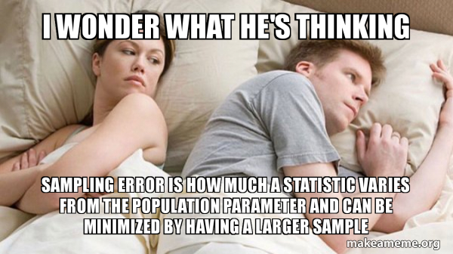
Total Survey Error Framework
Sampling Error
Sampling error arises when only a subset (sample) of the population is surveyed rather than the entire population.
Error reflects the variability that arises from using a sample to make inferences about the broader population
In web surveys, sampling error occur if the sample selected doesn’t perfectly represent the population’s diversity
Example
In a web survey on online shopping habits, there is a larger proportion of younger respondents compared to older adults
The survey results may be skewed toward younger perspectives on online shopping (sampling bias).
Meme using the I wonder what he’s thinking template, retrieved from Make a Meme, https://makeameme.org/meme/i-wonder-what-8e515bc5e8 (accessed 25 June 2025)
Notes:
Next, let’s look at sampling error. This happens when we’re only surveying a subset of our target population, rather than everyone in it. Whenever we rely on a sample, there’s a chance the group we’ve chosen might not perfectly represent the broader population. This can introduce variability and sometimes lead to skewed results.
In web surveys, sampling error is common if the selected sample doesn’t capture the diversity of the whole population. For instance, if we’re surveying online shopping habits and our sample includes mostly younger people, we might miss out on the perspectives of older adults. This can lead to sampling bias, where the results reflect the views of a particular group rather than the whole population.

Slide 21
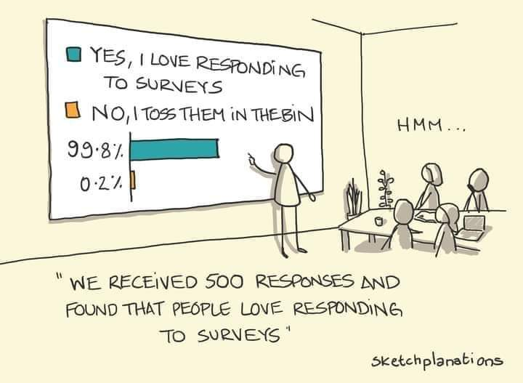



Total Survey Error Framework
Nonresponse Error
Nonresponse error occurs when individuals selected for the survey do not participate.
This error can lead to biased results if the non-respondents differ significantly from respondents in ways related to the survey topic.
In web surveys, response rates tend to be lower than other survey modes
Example
In a web survey about digital literacy, those with lower digital skills may be less likely to respond.
This could lead to an overestimation of digital literacy skills in the overall population (nonresponse error)
Hey, J. (2021). Sampling bias. Retrieved June 25, 2025, from https://sketchplanations.com/sampling-bias
Notes:
Now, let's discuss nonresponse error. This happens when individuals selected for the survey simply don’t participate. If the people who choose not to respond differ in important ways from those who do, especially in ways related to the survey topic, this can skew our results.
In web surveys, nonresponse rates tend to be higher than in other modes.
For example, in a survey about digital literacy, individuals with lower digital skills might be less inclined to participate. This could lead to an overestimation of digital literacy levels in the population, creating what we call nonresponse bias.

Slide 22



Total Survey Error Framework
Adjustment Error
Adjustment error occurs during the data processing phase when researchers apply adjustments or weights to correct for coverage, sampling, or nonresponse errors.
These adjustments can introduce errors if the weighting or adjustment models are inaccurate.
In web surveys, adjustments are often made to account for demographic imbalances.
Example
In a web survey on political opinions, weights are applied to compensate for underrepresentation of older respondents.
If the weighting model does not accurately reflect the political leanings of the older population, it can lead to biased estimates of overall political opinions (adjustment bias).
Notes:
Finally, we have adjustment error. This comes into play during data processing, where researchers apply adjustments or weighting to correct for things like coverage, sampling, or nonresponse issues. These adjustments aim to make the sample more representative, especially in web surveys where demographic imbalances can be common.
However, if the adjustment model is off—say, the weights don’t accurately reflect the true characteristics of the population—it can introduce its own errors. For example, in a web survey about political opinions, researchers might weight responses to compensate for an underrepresentation of older respondents. But if the model doesn’t capture the true political leanings of the older population, the final results could end up biased.
This is what we call adjustment bias and it is a risk we need to keep in mind when interpreting survey findings.

Slide 23
Exercise: Identifying Representation Errors
What type of response error is this?
Scenario 1
You are conducting a web survey on internet usage habits, but your sampling frame only includes people who subscribe to a high-speed internet provider.
Coverage error
Scenario 2
You are surveying a group of university students, but you only randomly select 50 participants from one campus, even though the university has 10 campuses.
Sampling error
Scenario 3
You send out a survey to 1,000 employees at a company, but only 200 respond, and the majority of nonrespondents are from entry-level positions.
Nonresponse error
Notes:
Now let’s do a short exercise to apply what we’ve just learned about response errors.
I will show you three short scenarios – one at a time. Your task is to identify what kind of representation error each scenario illustrates.
Please feel free to say your guess out loud or use the chat. After each round, I’ll reveal the correct answer and briefly explain why.
Let’s start with Scenario 1…

Slide 24


Total Survey Error Framework
Minimizing Representation Errors
Minimize survey errors to ensure data quality (accuracy, representativeness, and reliability)
Population Mean
Effective recruitment
Coverage Error
Sampling Frame
Sampling strategy
Sampling Error
Sample
Participant Motivation and Incentivization
Nonresponse Error
Respondents
Adjustment Error
Accurate Weighting Models
Postsurvey Adjusted Data
Survey Statistic
Figure adapted from Figure 2.5 in Groves, R.; Fowler, F.; Couper, M.; Lepkowski, J.; Singer, E.; Tourangeau, R. (2009). Survey Methodology (2nd Edition). John Wiley & Sons, Inc. ISBN 0-470-46546-8
Notes:
So how to minimize this representation errors.
Here’s what we can focus on:
Klick
With effective recruitment, we can find and attract the right participants to ensure our sample matches our target population as closely as possible.
Klick
The Sampling strategy is about choosing a sampling approach that best represents the diversity within the population.
Klick
With participant motivation and incentivization, you can make sure participants are motivated to respond thoughtfully and completely, perhaps through incentives or engaging survey design.
Klick
As we saw with adjustment error, careful weighting can help correct for sample imbalances. However, we need these models to be precise to avoid introducing new biases.
These strategies help address coverage, sampling, nonresponse, and adjustment errors. However, weighting and measures like imputation is something we cannot cover in today’s workshop.
Klick
But recruiting, sampling, motivation and incentivization are the core topics we are going to discuss in the next two, two and a half ours.

Slide 25

Break
25

Slide 26
Sampling in Web Surveys
Notes:
So, sampling in web surveys.

Slide 27
Sampling
Why have a good sampling strategy?
helps to select participants in a way that reflects the diversity of the population being studied (representativeness)
aligns the survey design with the research objectives
ensures that the results are statistically valid and generalizable, despite the limitations of a web-based approach
avoid wasting resources on collecting excessive or unhelpful data
increases the credibility of the findings, as stakeholders can see that the sampling was intentional and methodical
Notes:
Here’s why having a solid sampling strategy matters:
First, it helps us select participants in a way that captures the diversity of our population. This is essential for representativeness, making sure our findings can actually speak to the broader group we’re studying.
It also aligns the survey design with our research objectives, ensuring we’re collecting the right kind of data to answer our research questions.
A good sampling strategy makes our results more statistically valid and generalizable, even within the limitations of online surveys. This is key to building confidence in our data.
It helps us use resources wisely. Instead of collecting data that doesn’t really contribute, we focus on useful, relevant data, saving both time and budget.
Finally, it boosts the credibility of our findings. Stakeholders and audiences will trust the results more if they see that the sampling was done in a thoughtful and methodical way.

Slide 28




Sampling
Population
The complete set of individuals that share common characteristics and are the focus of a survey study.
Group from which researchers intend to make inferences.
All doctoral candidates admitted to (registered at) German HEIs, following the University Statistics Act (HStatG section 5)
Persons living in private households in Germany and aged 16-75 at the time of recruitment.
Briedis, K., Lietz, A., Ruß, U., Schwabe, U., Seifert, M., Mühleck, K., Scheller, P., Teichmann, C., de Vogel, S., Weber, A., Schmidtchen, H., Birkelbach, R., Hoffstätter, U. & Oestreich, T. (2024). Nacaps 2018 - Data and methods report on the National Academics Panel Study 2018 (1st-4th wave - doctoral candidates). Hanover: RDC-DZHW
German Internet Panel (GIP), University of Mannheim. (2005). Setting up an online panel representative of the general population. Retrieved July 9, 2025, from https://paneldata.org/gip/
full-time academic and artistic staff at German universities and equivalent institutions at the time of recruitment.
All people aged 18 to 49 living in Germany in 2020.
Fabian, G., Heger, C., Just, A., Weber, A. & Oestreich, T. (2025). DZHW Scientists Survey 2023. Data and methods report on the DZHW Scientists Survey 2023. Hanover: German Centre for Higher Education Research and Science Studies (DZHW). https://doi.org/10.21249/DZHW:scs2023-dmr-en:1.0.1
Häring, A., Ruland, M., Von der Burg, K., Gilberg, R., Aust, F. (2022). Methodenbericht FReDA. Das familiendemografische Panel. Infas: Bonn. Rerieved july 9, 2025 from https://www.freda-panel.de/FReDA/DE/Publikationen/Datendokumentation/Downloads/Release_5/Field-Reports/down_r5-0_method-report-infas-w1.pdf?__blob=publicationFile&v=3
Notes:
Let’s start with some key terms first to bring everyone on the same page what we are talking about. First of all, population.
When we talk about the population in a survey context, we’re referring to the entire set of individuals who share certain characteristics and are the focus of our study. This is the group from which we want to draw conclusions.
Klick
These are examples I took from different web survey studies websites on how they define their populations based on their specific research needs.
For example, the Nacaps study defined population of the new cohort are all people who started a PhD at a German University within the German Academic Year:
The idea is always to capture the group you want to learn about.

Slide 29
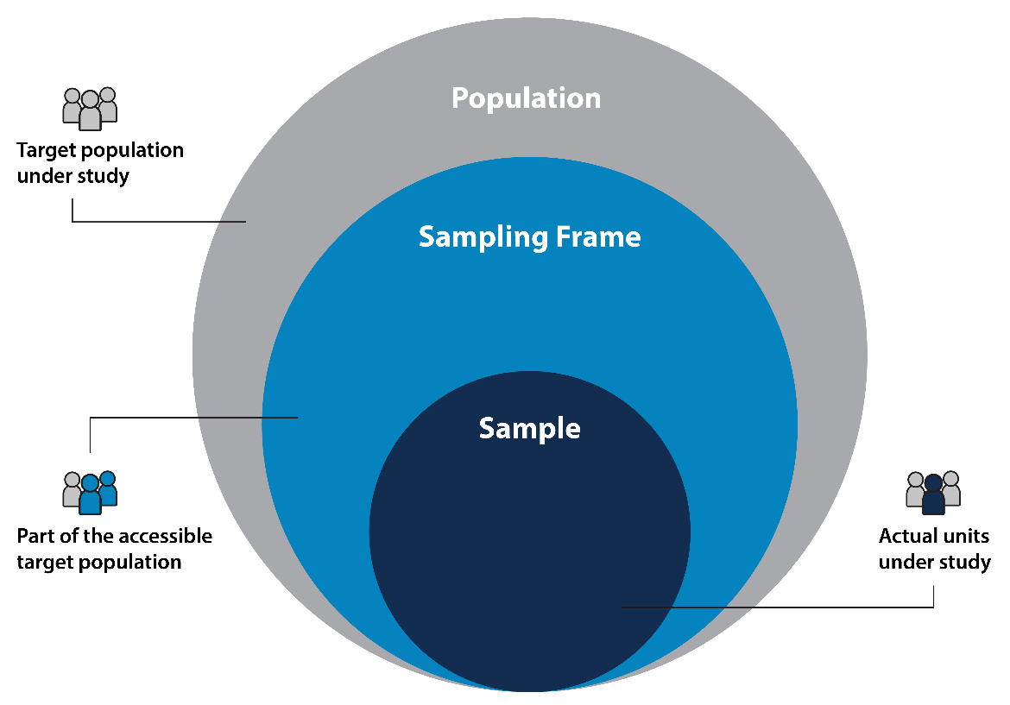
Sampling
Sampling Frame
Specific list or database of individuals in the target population from which a sample can be drawn for a survey.
practical means to access the population and is crucial for defining who has a chance of being selected in the sample.
PhD students enrolled as a student at a HEI supporting Nacaps.
Briedis, K., Lietz, A., Ruß, U., Schwabe, U., Seifert, M., Mühleck, K., Scheller, P., Teichmann, C., de Vogel, S., Weber, A., Schmidtchen, H., Birkelbach, R., Hoffstätter, U. & Oestreich, T. (2024). Nacaps 2018 - Data and methods report on the National Academics Panel Study 2018 (1st-4th wave - doctoral candidates). Hanover: RDC-DZHW
Researchers with address information found on the websites of universities and equivalent institutions on the internet.
Fabian, G., Heger, C., Just, A., Weber, A. & Oestreich, T. (2025). DZHW Scientists Survey 2023. Data and methods report on the DZHW Scientists Survey 2023. Hanover: German Centre for Higher Education Research and Science Studies (DZHW). https://doi.org/10.21249/DZHW:scs2023-dmr-en:1.0.1
Khandelwal, A. (2021) A Complete Guide on Sampling Techniques for Data Science. Retrieved June 25, 2025 from Analytics Vidhya, www.analyticsvidhya.com/blog/2021/09/a-complete-guide-on-sampling-techniques/.
Notes:
Sampling frame is the actual list or database that gives us a practical way to access our population. This is a tool that defines who can be selected for our survey.
Klick
For instance, if we’re studying Ph.D. students, the sampling frame might be a list of students enrolled in universities that support a particular survey, like the Nacaps study. This frame is essential because it impacts who has a chance of being in our sample, and ideally, it should represent our target population as closely as possible.

Slide 30
Sampling
Sample
The specific group of individuals chosen from the target population to participate in the survey.
selected based on certain criteria or sampling methods to ensure that it accurately represents the larger population
Multi-stage random samples which are regionally clustered, 2012 and 2014 samples are additionally clustered in households
Full census
Briedis, K., Lietz, A., Ruß, U., Schwabe, U., Seifert, M., Mühleck, K., Scheller, P., Teichmann, C., de Vogel, S., Weber, A., Schmidtchen, H., Birkelbach, R., Hoffstätter, U. & Oestreich, T. (2024). Nacaps 2018 - Data and methods report on the National Academics Panel Study 2018 (1st-4th wave - doctoral candidates). Hanover: RDC-DZHW
German Internet Panel (GIP), University of Mannheim. (2005). Setting up an online panel representative of the general population. Retrieved July 9, 2025, from https://paneldata.org/gip/
Random sample of 60,002 addresses, disproportionally stratified (with an oversampling of female professors and postdocs)
Random two-stage sampling from the population registers of selected municipalities in Germany.
Fabian, G., Heger, C., Just, A., Weber, A. & Oestreich, T. (2025). DZHW Scientists Survey 2023. Data and methods report on the DZHW Scientists Survey 2023. Hanover: German Centre for Higher Education Research and Science Studies (DZHW). https://doi.org/10.21249/DZHW:scs2023-dmr-en:1.0.1
Häring, A., Ruland, M., Von der Burg, K., Gilberg, R., Aust, F. (2022). Methodenbericht FReDA. Das familiendemografische Panel. Infas: Bonn. Rerieved july 9, 2025 from https://www.freda-panel.de/FReDA/DE/Publikationen/Datendokumentation/Downloads/Release_5/Field-Reports/down_r5-0_method-report-infas-w1.pdf?__blob=publicationFile&v=3
Notes:
Now let’s discuss what we mean by a sample. This is the specific group of individuals we actually select from the target population to participate in our survey.
The sample is chosen based on criteria or sampling methods to represent the larger population accurately.
Klick
For example, in the Nacaps study, they use the full population of Ph.D. students enrolled at supporting institutions. In other cases, like the German Internet Panel, we see more complex sampling approaches, like multi-stage random samples that are regionally clustered.

Slide 31

Sampling
Sampling Strategies
Probability Sampling
every member of the population has a known, non-zero chance of being selected.
yield representative samples
allow for generalization to the broader population
Simple random sampling
Systematic sampling
Stratified sampling
Cluster sampling
Frommknecht, A. (n.d.). “Lotto-Fee” Franziska Reichenbacher. Retrieved July 9, 2025, from https://kress.de/news/beitrag/117398-ard-samstags-lotto-mit-festem-sendeplatz-um-19-57-uhr.html
Notes:
Here, we have two main types of sampling strategies: Probability Sampling and Non-Probability Sampling.
In Probability Sampling, every member of the population has a known, non-zero chance of being selected, which helps us achieve representative samples and allows for generalization to the broader population.
There are different types of probability sampling.

Slide 32
Probability Sampling
Simple Random Sample
Every individual in the population has an equal chance of being selected.
Adapted from: Scribbr. (n.d.). Sampling methods. Retrieved July 9, 2025, from https://www.scribbr.com/methodology/sampling-methods/
How?
Participants are chosen randomly, often using tools like random number generators.
Pros
Minimizes sampling bias
Straightforward and easy to understand
Results are highly generalizable to the population
When to Use
When you have a complete and accessible list of the population
When aiming for the highest level of representativeness
For studies where random, unbiased samples are crucial
Example
A university uses a random number generator to select 500 students from a list of all enrolled students for a satisfaction survey.
Notes:
In a Simple Random Sample, every individual in the population has an equal chance of being selected.
Klick
So, how does it work? Participants are chosen randomly, often with tools like random number generators to ensure fairness.
For example, let’s say a university wants to survey students. They could use a random number generator to pick 500 students from a full list of enrolled students for their survey.
Klick
The main advantage here is that it minimizes sampling bias, is straightforward, and allows results to be highly generalizable.
When should you use this method? When you have a complete, accessible list of the population, want maximum representativeness, or need truly random samples.

Slide 33
Probability Sampling
Systematic Sampling
Individuals are selected at regular intervals (k) from a sorted list.
How?
1. approximate the population size, N.
2. Determine the sample size desired, n.
3. Compute N/n and round down to the nearest integer. This value is k.
4. Randomly select a number between 1 and k as starting point
Example
Starting with a random starting point, a researcher selects every 3rd name on a list of patients to survey them about their healthcare experience.
Adapted from: Scribbr. (n.d.). Sampling methods. Retrieved July 9, 2025, from https://www.scribbr.com/methodology/sampling-methods/
Pros
Simpler and faster than simple random sampling
Provides a high level of representativeness, similar to simple random sampling.
Easy to implement if a complete list is available.
When to Use
When you want an efficient method for sampling without complex randomization.
For surveys where the population is evenly distributed and not cyclically patterned.
Notes:
In Systematic Sampling, instead of selecting individuals purely at random, we pick them at regular intervals from a sorted list.
Klick
How does it work? First, you figure out your total population size and decide on your sample size. Then, you divide the population by the sample size to get your interval (let’s call it k). Start with a randomly selected point, and then pick every kth individual from there.
For example, if a researcher starts at a random point on a patient list and picks every third name, they’re using systematic sampling.
Klick
Why use it? It’s often simpler and faster than pure random sampling while still keeping a high level of representativeness.
This approach works best when you have an organized list and a population that doesn’t have any cyclical patterns.

Slide 34
Probability Sampling
Stratified Sampling
The population is divided into distinct subgroups (strata) based on specific characteristics (e.g., age, gender), and random samples are drawn from each stratum.
Adapted from: Scribbr. (n.d.). Sampling methods. Retrieved July 9, 2025, from https://www.scribbr.com/methodology/sampling-methods/
Pros
Ensuring all subgroups are proportionally represented.
Reduces sampling error, especially when there are significant differences between strata.
When to Use
When the population has clear subgroups relevant to the research (e.g., gender, income levels).
When the study aims to understand differences across specific subgroups (e.g., comparing age groups’ preferences).
How?
1. Define the population N.
2. Divide the population into distinct subgroups (strata)
3. Determine sample size n and for each stratum
4. Randomly Select Individuals Within Each Stratum
Example
A survey on careers of university graduates may divide the sample by discipline and randomly select graduates from each discipline.
Notes:
In Stratified Sampling, we divide the population into distinct subgroups, or strata, based on specific characteristics like age, gender, or education level. Then, we randomly select individuals from each stratum.
Klick
Here’s how it works: First, define the entire population, then split it into relevant subgroups. Determine the sample size for each subgroup and randomly pick individuals from each.
For example, in a study on university graduates, we could divide them by academic discipline and sample graduates from each group.
Klick
The benefit? Stratified sampling ensures that all key subgroups are represented, which can reduce sampling error and allow for more accurate insights into each group.
It’s particularly useful when you’re interested in comparing subgroups within the population.

Slide 35
Probability Sampling
Cluster Sampling
The population is divided into clusters (e.g., geographic areas, schools), and entire clusters are randomly selected.
How?
1. Define the population N.
2. Divide the population into naturally occurring clusters
3. Decide on the number of clusters
Select clusters randomly
Example
A survey on university graduates may divide the sample by HEI and randomly select HEIs whos graduates all are invited to the survey
Adapted from: Scribbr. (n.d.). Sampling methods. Retrieved July 9, 2025, from https://www.scribbr.com/methodology/sampling-methods/
Pros
Cost-effective and practical for large or geographically dispersed populations.
When to Use
When the population is large and spread out over a wide area (e.g., national or regional surveys).
For studies where clusters are naturally occurring units, such as schools, neighborhoods, or regions
Useful when a complete list of individuals is not available, but clusters are accessible.
Notes:
In Cluster Sampling, the population is divided into naturally occurring groups, or clusters, such as geographic areas or institutions, and then a selection of these clusters is randomly chosen for surveying.
Klick
Here’s the process: First, define the total population and divide it into clusters. Decide on the number of clusters needed, then randomly select those clusters. Within each selected cluster, you survey every member or a sample of members.
For instance, if you’re studying university graduates, you might divide the sample by institutions and then randomly select several universities to survey graduates.
Klick
This approach is especially useful when the population is widespread geographically. It’s cost-effective and practical, particularly when you don’t have a complete list of all individuals but do have access to cluster lists.

Slide 36

Sampling
Sampling Strategies
Probability Sampling
Non-Probability Sampling
every member of the population has a known, non-zero chance of being selected.
yield representative samples
allow for generalization to the broader population
not all individuals in the population have a known chance of being selected.
easier to implement
may introduce bias
Simple random sampling
Systematic sampling
Stratified sampling
Cluster sampling
Convenience sampling
Quota sampling
Purposive sampling
Snowball sampling
Self-selection sampling
Frommknecht, A. (n.d.). “Lotto-Fee” Franziska Reichenbacher. Retrieved July 9, 2025, from https://kress.de/news/beitrag/117398-ard-samstags-lotto-mit-festem-sendeplatz-um-19-57-uhr.html
Torbz (n. d.) Adobe Stock (Image ID: 44819826). Retrieved July 9, 2025 from https://as1.ftcdn.net/v2/jpg/00/44/81/98/1000_F_44819826_vXbbjtn8KLQaSoXbrghP9oRzSHw6slid.jpg
Notes:
Another group of sampling strategies fall under the umbrella of non-probability sampling
On the other hand, Non-Probability Sampling doesn’t guarantee that everyone has a chance of being included. It’s often easier and quicker to implement but can introduce biases that might limit the generalizability of our results.
I'll go into more detail on each of these methods in the next few slides.

Slide 37

Non-Probability Sampling
Convenience Sampling
Adapted from: Scribbr. (n.d.). Sampling methods. Retrieved July 9, 2025, from https://www.scribbr.com/methodology/sampling-methods/
Participants are selected based on their availability and ease of access.
How?
Post the survey on a website, social media, or email it to a readily available contact list
Anyone who comes across the survey link to participate
Example
A university professor conducts a web survey on study habits and shares the survey link in her classes and through her department’s online student portal.
Pros
Quick and easy to reach respondents.
Cost-effective as it requires minimal resources and outreach.
When to Use
When time and resources are limited
For exploratory or pilot studies, such as testing new survey questions
When representativity is less important
When targeting specific website visitors or communities
Notes:
This was probability sampling. Now about non-probability sampling.
Convenience sampling is one of the simplest and most widely used non-probability sampling methods. Here, participants are chosen based on their availability and accessibility to the researcher rather than through a systematic selection process. This method is often used in exploratory research or when quick, easy access to participants is a priority.
Klick
Usually, the researcher posts the survey link in accessible spaces, like a website, social media, or an email newsletter. Anyone who comes across the link and is interested can participate in the survey.
Convenience sampling is straightforward, as it utilizes readily available participants, reducing recruitment time and effort. It requires minimal resources for outreach, making it suitable for studies with limited budgets.
Klick
Convenience sampling is often a practical choice for short-term projects.
This method is beneficial for testing new survey questions or gathering preliminary data.
Since the sample may not reflect the broader population, this method is best suited for research where generalizability is not the primary goal.
Imagine a professor wants to survey her students about study habits. She shares the survey link via the online student portal, making it accessible to any student who wishes to participate.

Slide 38

Non-probability Sampling
Quota Sampling
The target population is divided into subgroups, and a specified quota of responses is sought from each group. Selection within each group is not random.
Adapted from: Scribbr. (n.d.). Sampling methods. Retrieved July 9, 2025, from https://www.scribbr.com/methodology/sampling-methods/
How?
Set quotas for specific demographic groups (e.g., age, gender) based on survey needs
use screening questions to filter and recruit respondents until each quota is filled
Example
A researcher uses an online survey platform to recruit respondents and tracks ages quotas in real-time, stopping data collection for each age group once the quota is met.
Pros
More structured than convenience sampling and helps balance the sample.
When to Use
When it’s important to compare subgroups (e.g., comparing opinions by age or gender).
When complete random sampling is impractical, but you still want proportional representation.
Notes:
Quota sampling divides the target population into subgroups (quotas) based on specific characteristics, such as age or gender. The researcher then seeks a specified number of responses from each subgroup. While participants within each subgroup are not randomly selected – and this is the key difference to stratified sampling - quota sampling helps to ensure representation from key demographic groups.
Klick
For example, if you need responses from various age groups, you might set quotas to gather a specific number from each demographic.
Klick
This approach is structured and helps balance the sample, making it especially useful when we need to compare subgroups, such as age or gender, or when full random sampling isn’t feasible but we still want proportional representation.

Slide 39
Non-Probability Sampling
Purposive Sampling
Adapted from: Scribbr. (n.d.). Sampling methods. Retrieved July 9, 2025, from https://www.scribbr.com/methodology/sampling-methods/
Participants are selected based on specific criteria or characteristics relevant to the research objectives.
How?
Define criteria for inclusion (e.g., expertise or experience)
Use targeted recruitment through professional networks, specialized forums, or social media groups where likely participants are active.
Pre-screening questions in the survey
Example
A health researcher is studying attitudes toward telemedicine among healthcare providers. She emails the survey link to known practitioners who use telemedicine frequently.
Pros
Quick and easy to reach respondents.
Cost-effective as it requires minimal resources and outreach.
When to Use
For studies requiring knowledgeable or experienced participants (e.g., professionals in a specific field
When researching niche topics or communities
Notes:
In Purposive Sampling, we select participants based on specific criteria relevant to our research objectives. This approach is often used in research requiring input from experienced or informed participants in a particular field.
Klick
For instance, if a health researcher is exploring attitudes toward telemedicine, they might target healthcare providers who frequently use telemedicine, reaching out through professional networks or specialized forums.
Klick
Purposive sampling is particularly helpful for niche topics or when the study requires participants with a certain level of expertise or experience. This method is often less time-intensive, as the focus is on reaching specific individuals rather than a broad sample.

Slide 40
Non-Probability Sampling
Self-Selection Sampling
Adapted from: Scribbr. (n.d.). Sampling methods. Retrieved July 9, 2025, from https://www.scribbr.com/methodology/sampling-methods/
Participants opt into the survey voluntarily.
How?
Post a survey link openly on a website, social media, or in an email newsletter, allowing anyone interested to participate.
Online-Access Panels (e.g. SosciPanel)
Example
A news website posts an online poll asking readers their opinions on climate change. The survey link is open to anyone who visits the website, allowing readers to voluntarily participate by clicking the link.
Pros
Simple to implement and can gather a large number of responses quickly.
Cost-effective and requires minimal outreach.
When to Use
When a high volume of responses is beneficial, such as for exploratory research
When a broad range of opinions is sought
representativeness is less critical
Notes:
Self-selection sampling is a type of non-probability sampling where individuals voluntarily decide to participate in a study. This method is widely used in online surveys, where the survey link is made publicly available, allowing anyone who is interested to participate. It’s commonly used when researchers are looking for quick responses or are conducting exploratory studies.
Klick
The survey link is posted openly, such as on a website, social media, or through an email newsletter. Anyone who encounters the link and is interested can participate in the survey.
Sometimes, online access panels like SosciPanel are used, where people are pre-registered to participate in surveys.
Klick
This method is very easy to set up and doesn’t require targeted recruitment. It’s an accessible option when aiming to collect a large number of responses quickly. Since outreach is minimal and relies on voluntary participation, there are fewer resource demands compared to other methods.
This method is ideal for exploratory research where a large volume of responses provides a wide range of opinions. For studies that benefit from varied perspectives, this approach allows for diverse input. Because self-selection sampling doesn’t guarantee representativeness, it’s better suited to studies where generalizability is not the primary goal.
Your probably wondering now about the difference between convenience sampling and self-selection sampling.
One of the main differences between voluntary and convenience sampling is the level of participation and motivation of the participants. In voluntary sampling, participants choose to take part in the research of their own accord, which means they may have a higher interest or engagement in the topic or research. In convenience sampling, participants are selected based on their availability and accessibility, meaning they may have less interest or involvement in the topic or research.
Another difference between voluntary and convenience sampling is the level of control and flexibility for the researcher. In voluntary sampling, the researcher has less control over who participates in the research, which can result in a biased or non-representative sample. In convenience sampling, the researcher has more control over who participates, allowing for some adjustments or refinements to the sample.

Slide 41
Non-Probability Sampling
Snowball Sampling
Adapted from: Scribbr. (n.d.). Sampling methods. Retrieved July 9, 2025, from https://www.scribbr.com/methodology/sampling-methods/
Initial participants refer other qualified participants, creating a network-based sample that grows over time.
Pros
Effective for reaching hard-to-reach populations (e.g., certain social groups, online communities).
Cost-effective, as it relies on referrals rather than broad recruitment.
When to Use
When studying populations difficult to identify or access (e.g., people with specific health conditions)
For social research focused on communities or network-based studies.
How?
Begin with a small group of participants recruited via online forums, social media, or email, then ask them to share the survey with others who meet the study criteria.
Example
A sociologist wants to survey freelancers about job satisfaction and uses a few initial contacts from LinkedIn. She asks these initial participants to share the survey link with other freelancers they know.
Notes:
Snowball Sampling is a type of non-probability sampling particularly useful when the target population is difficult to access or identify through conventional sampling methods. In this method, you start with a small group of initial participants—sometimes called "seeds"—who meet the study criteria. These initial participants are then asked to refer other individuals they know who also qualify for the study. This process is repeated, creating a "snowball effect," with the sample growing as more people are referred into the study.
Klick
Let’s say a sociologist is studying job satisfaction among freelancers. She starts by recruiting a few initial contacts from LinkedIn who are freelancers and meet her study criteria. These participants are then asked to share the survey link with other freelancers they know. Over time, the network grows as more freelancers are referred and join the study, allowing the researcher to reach a larger, but still targeted, sample.
Klick
Snowball sampling works well for populations that are difficult to locate, such as specific social or cultural groups, online communities, or people with shared characteristics or experiences.
It minimizes the need for extensive recruitment efforts by leveraging participants' networks, which can be resource-efficient, especially when broad outreach is challenging or impractical.
This approach is ideal when studying groups that are not easily identifiable, like individuals with rare health conditions, specific professional skills, or marginalized social groups.
It is often used in social or behavioral research, where community bonds or personal networks are central to understanding the population.

Slide 42





Exercise: Matching Research Scenarios with Sampling Strategies
Match each scenario to the most suitable sampling strategy.
Scenario
Strategy
Sampling Strategies
Simple random sampling
You want to measure student satisfaction across all universities in a country and randomly select 1,000 students from a national database.
Simple random sampling
Stratified sampling
Cluster sampling
To study voter behavior, you ensure proportional representation by sampling voters based on age groups
Stratified sampling
Convenience sampling
Snowball sampling
You’re researching opinions about a new social media platform and survey people who respond to a link you post on Instagram
Convenience sampling
You are studying cybersecurity practices among freelance developers. Since there is no public list, you start with 10 developers you know and ask them to recommend others.
Snowball sampling
To study the effectiveness of a vaccination campaign in urban areas, you randomly select 10 cities and survey all residents in those cities.
Cluster sampling
Notes:
You’ll see five different sampling strategies listed here on the right – each one represented by an icon.
On the left, you see several short scenarios.
Please use your stamp or marker tool to select the strategy you think best matches the scenario – just place your icon in the middle column next to your guess. We’ll look at the results together and I’ll then reveal the correct answer and explain why. This is not about getting everything right – it’s just a fun way to check our understanding.

Slide 43
Sampling
Sample Size
Why sample size matters
Ensures the survey results accurately represent the population
Reduces the margin of error and increases confidence in results
Balances the need for robust data with resource constraints (time, money, etc.)
Key factors influencing sample size
Population size
Margin of error (confidence interval, typically +/- 5%)
Confidence level ( 95% or 99%)
Variability
Sampling strategy
Anticipated response rate
Tools & Guidelines
Stata power ado
R pwr and practools packages
Australian Bureau of Statistics Sample Size Calculator
UK Sample Size Calculator
G*Power Desktop Application
Gesis Sample Size Calculation For Complex Sampling Designs
Notes:
Let’s take a moment to talk about sample size.
Klick
A properly calculated sample size is essential because it ensures that your results truly reflect the population you're studying.
It also reduces the margin of error, giving you more confidence in your findings.
At the same time, it’s about finding the right balance—getting robust data without overextending your resources like time or budget.
Klick
Now, several factors come into play when determining the sample size.
First, you need to think about the size of the population you’re drawing from—how many people are in the group you’re studying.
Then there’s the margin of error, which is often set to a range like plus or minus 5%, and the confidence level, typically 95%, but sometimes higher if you need greater certainty.
You also have to consider variability—how diverse your population is—as well as your sampling strategy and the response rate you expect. If you think fewer people will respond, you’ll need to plan for that by oversampling.
For those of you wondering how to actually calculate this, I’d point you to a couple of helpful resources.
Klick
There’s a sample size calculator from the Australian Bureau of Statistics, which is great for simpler cases like random sampling, as well as the UK sample size Calculator
There is also a free desktop application galled G*power developed by the university of Düsseldorf.
For those of you working with Stata and R, there are ados or packages which I linked here.
And for more complex designs, the GESIS guide is an excellent reference.

Slide 44



Sampling
What to consider in choosing a sampling strategy?
Project needs
Research objectives
Generalizability requirements
Sample size/ statistical power
Urgency
Compatibility with survey design
Target population characteristics
Population accessibility
Digital Literacy
Privacy and Anonymity
Resource constraints
Budget limitations
Time constraints
Technical resources
Others
Fraud prevention
GDPR compliance
Notes:
When choosing a sampling strategy, there are several factors we need to keep in mind to ensure that our survey not only reaches the right people but also meets our project goals effectively.
Klick
First, think about the populations characteristics: This includes how accessible the population is—are they easy to reach? What about their digital literacy—will they be comfortable with an online survey? And importantly, how sensitive is the data? Issues of privacy and anonymity are crucial, especially if we’re handling personal information.
Klick
Next, consider your projects needs. What are the research objectives? Do we need results that are generalizable, meaning they represent a larger population? What sample size do we need to achieve statistical power, and how urgent is the data collection? Also, is our sampling strategy compatible with the overall survey design?
Klick
Resource constraints also play a big role. Budget limitations, time constraints, and the technical resources available all can influence the feasibility of certain sampling methods.
Klick
Finally, don’t overlook legal and security aspects. For example, fraud prevention measures are essential to ensure data quality, and if you’re operating within the EU or targeting EU residents, GDPR compliance is non-negotiable.

Slide 45
Participant Recruitment
Notes:
All right, after we talked about Sampling Strategies and why they are important, I want to continue with participant recruitment in web survey design.

Slide 46


Participant Recruitment
Recruiting modes
Personal
Directly contacting individuals with a customized or individualized message.
Impersonal
General invitations sent to a broader audience without customization for individual participants.
Postal
E-Mail
Direct Messages on Social Media
Mass emails
Social Media Post or Ads
Website Banners or Pop-Ups
Online Panels
Notes:
Now, let’s take a quick look at the two main approaches to recruiting participants: personal and impersonal recruiting modes.
Personal recruiting involves directly reaching out to individuals with tailored, often one-on-one messages—think emails, postal invites, or direct messages.
On the other hand, impersonal recruiting takes a broader approach. Here, we’re talking about mass emails, social media posts, or even online panels where invitations go out to a large group without personalization.
Each has its own strengths and is suited to different types of studies, which we’ll get into in the following slides.

Slide 47


Personal Recruitment
Posted invitation letter
Physical letter sent via postal mail that invites recipients to participate in a web survey.
The letter includes the survey URL or a QR code, a unique access code (if needed), and any instructions for accessing the survey online.
Pros
A physical letter can feel more official and trustworthy
Physical mail can convey a more personal touch, showing that effort was made to reach out individually
Postal invitations are unaffected by spam filters
Cons
High printing, postage, and distribution costs
Longer lead time
Some recipients may discard unsolicited mail
Switching from letter to online mode can pose a barrier
Notes:
A posted invitation letter is just what it sounds like—an invitation sent through regular postal mail. This physical letter invites recipients to take part in an online survey, and usually includes all the info they need to access it, like a survey URL or a QR code, plus any specific instructions or access codes.
Klick
Now, why would we go this route? Well, a physical letter often feels more official and credible—something people might take more seriously. It can also feel a bit more personal, showing that effort was made to reach out individually. And unlike emails, these letters won’t get caught up in spam filters.
Klick
Of course, there are some downsides. Printing, postage, and distribution all add up, and this approach requires a longer lead time to account for delivery. Some people might toss unsolicited mail without a second glance, and there’s also the slight hurdle of getting people to go from a letter to an online survey.

Slide 48


Personal Recruitment
E-Mail & Direct Message
Emails addressed to each participant by name with tailored content or sending personalized messages to connections on LinkedIn, Facebook, or other platforms.
Pros
Feels more exclusive than mass mails and can boost engagement
Emails or messages from recognizable organizations or individuals create trust
generally yield higher response rates compared to mass emails or social media posts
Participants can simply click on a link in the message
Cons
Crafting individualized emails is more time-intensive, especially for large samples
Risk of being marked as spam (use white lists!)
Notes:
Email and direct messaging are also about reaching out personally, whether it’s an email with the participant’s name in the greeting or a LinkedIn message that’s custom-made for them.
Klick
This approach feels much more exclusive than mass mailings, and it can really help engagement, especially when the message comes from a trusted or recognizable organization or person.
When you go this route, you tend to see higher response rates compared to more generic methods like mass emails or social media posts. It’s convenient for the participant too—they can just click a link in the message and be taken directly to the survey.
Klick
With emails, you can probably use serial letter function. But for social media messages, of course, the downside is the extra time it takes to craft each message, which can be challenging with large sample sizes. And there’s always the risk of emails being flagged as spam, so it’s worth considering using whitelists if possible.

Slide 49
Personal Recruitment
When to use?
Posted invitation letter
Email invitation and messages
Postal addresses are known and up-to-date
Target population prefers traditional communication (e.g. older adults, rural communities, or those less engaged with digital platforms)
For regional or community-based surveys, sending physical letters to a well-defined area can be effective
When offering physical incentives or rewards (e.g., mailed gift cards), a posted letter can complement the incentive and reinforce the survey’s legitimacy
E-mail address is known and up-to-date
For studies with fewer participants (e.g., expert panels or alumni surveys) where personalized communication can significantly boost participation.
When recruiting within organizations or interest groups with which you already have a relationship
Notes:
Let’s talk about when you might choose each of these invitation methods.
Klick
For the posted invitation letter, it’s a good option when you have up-to-date postal addresses, and especially when your target audience might prefer a traditional approach. Think of older adults, rural residents, or people who aren’t big on digital communication. This method also works well if your survey is regional or community-based, where sending physical letters to a defined area can really make an impact. Plus, if you’re offering physical incentives like gift cards, a posted letter adds a sense of legitimacy that helps reinforce the survey’s credibility.
Klick
Now, email invitations and messages are ideal when you have reliable email addresses for your participants. They’re perfect for studies with smaller groups, like expert panels or alumni surveys, where personal contact can really boost participation. Emails work well within organizations or interest groups where you already have an established relationship—they feel direct, immediate, and are easy for people to respond to.

Slide 50


Impersonal Recruitment
Mass emails
Sending a generic survey invitation to a large list of recipients, usually from an existing database or mailing list.
Pros
allow for large-scale recruitment with minimal effort
Cons
feel impersonal and are more likely to be ignored
may end up in spam folders
lower engagement than personalized emails
When to use?
There is a mailing lists, but recipients are unknown
Large-scale studies and/or broad audience
low-budget projects
Notes:
Now, let’s look at mass emails as a recruiting option. Mass emails are all about scale. They’re generic invitations sent out to large lists, often pulled from existing databases or mailing lists.
Klick
The main advantage here is that mass emails allow you to reach a wide audience with minimal effort, making them great for large-scale studies or when you’re on a tighter budget.
Klick
But, as you can imagine, there are some drawbacks. Mass emails can feel impersonal, so they’re more likely to be ignored. There’s also the risk of your message landing in the dreaded spam folder, and generally, engagement is lower than with more personalized approaches.
Klick
So, when should you consider using mass emails? They work best when you have a mailing list but don’t know much about the individual recipients, or if you’re targeting a broad audience. They’re also a practical choice for large studies or when resources are limited.

Slide 51
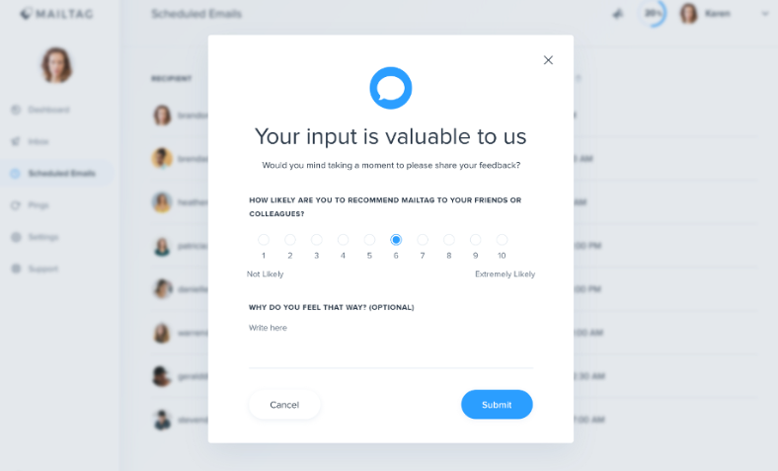
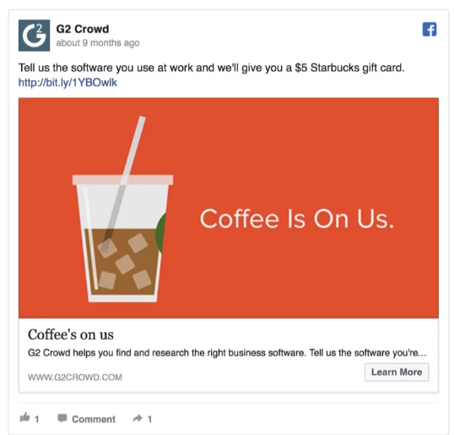
Impersonal Recruitment
Social media posts, ads and pop-ups
Posts
public or group-based posts on platforms like Facebook, LinkedIn, and Instagram, inviting followers or members of specific groups to participate in a survey.
Ads
paid promotions on platforms, specifically targeting demographics or interest groups relevant to the survey.
Pop-ups
on-page survey invitations that appear when users visit a website, app, or online platform.
OptiMonk. (n.d.). Website popup survey examples. Retrieved July 9, 2025, from https://www.optimonk.com/website-popup-survey-examples/
OptiMonk. (n.d.). Website popup survey examples. Retrieved July 9, 2025, from https://www.optimonk.com/website-popup-survey-examples/
Notes:
When it comes to recruiting via social media, there are several approaches we can take: posts, ads, and pop-ups. A post is pretty straightforward – it's just a public or group-based message on a platform like Facebook, LinkedIn, or Instagram, inviting people or specific groups to participate.
Ads are a bit more targeted; they’re paid promotions aimed at reaching specific demographics or interest groups.
And pop-ups are those on-page invitations you might see on a website or app, prompting visitors to take part in the survey right then and there.

Slide 52
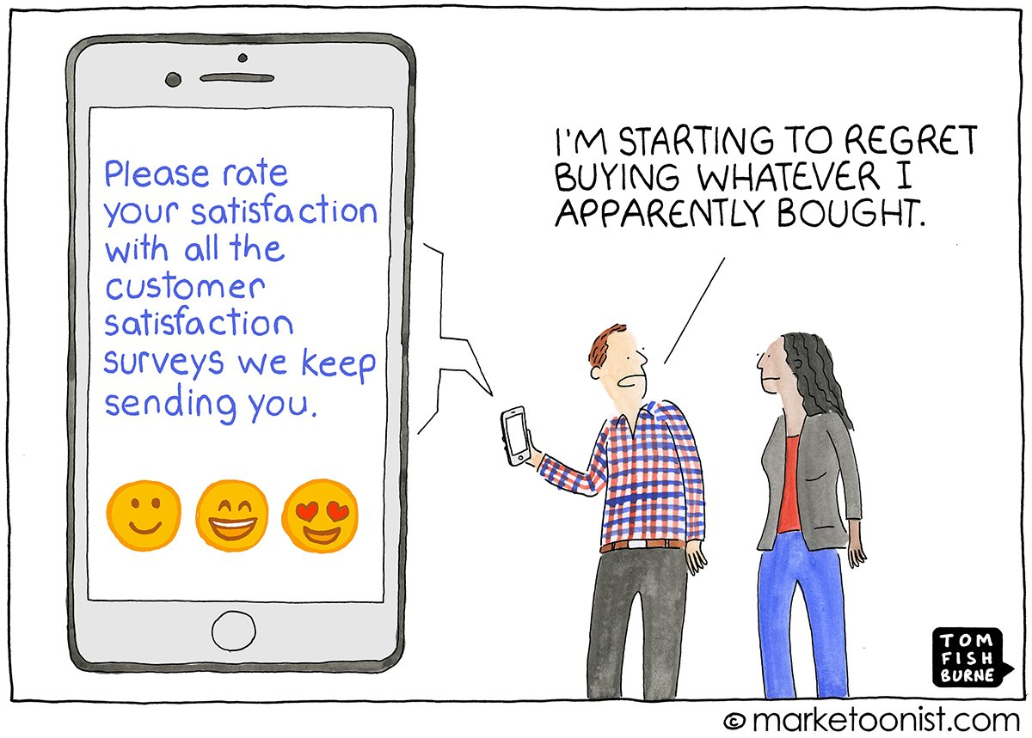
Impersonal Recruitment
Social media posts, ads and pop-ups
Pros
Easy to target specific communities
Social media platforms provide metrics on impressions, click-through rates, and engagement
Cons
may attract respondents outside the target group
excessive posts, ads and pop-ups can annoy users
When to use?
When looking for specific groups, feedback on specific website content or features
Fishburne, T./Marketoonist (n.d.). Please rate your satisfaction... Retrieved July 9, 2025, from https://marketoonist.com
Notes:
The beauty of these options is that they make it easy to reach specific communities, and you get helpful metrics, like impressions and click-through rates, which give insight into engagement.
Klick
But on the flip side, there are a couple of challenges. First, you might end up attracting respondents who aren’t exactly in your target group. Plus, if overdone, these posts, ads, or pop-ups can irritate users.
Klick
When is it a good idea to use social media recruiting? It’s particularly effective when you’re looking to engage specific interest groups or gather feedback on particular website content. This method works best when you know where your target group is already active online.

Slide 53
Impersonal Recruitment
Online Access Panels (Convenience Pools)
Pre-recruited pool of individuals who have agreed to participate in web-based surveys and research studies.
Panel providers maintain large databases of respondents and use profiling data (e.g., age, gender, income, interests) to match participants with surveys based on the study’s requirements.
Researchers specify the sample criteria they need, and the provider then distributes the survey link to matching panel members.
Pros
easy to recruit participants with certain characteristics
Quick data collection
Higher response rates than general population surveys.
Quality control measures to filter out low-quality respondents, including checks for speeding, straight-lining, and inconsistent answers.
Cons
Frequent participation in surveys may lead to “professional respondent” behavior
Panelists may be inclined toward survey participation for incentives.
costly, especially for large sample sizes or highly targeted segments (e.g., high-income earners, specific professionals).
Notes:
Online access panels, sometimes called convenience pools, are essentially groups of people who have already agreed to participate in web-based surveys. These panels are managed by providers who maintain large databases, using profiling data like age, gender, income, and interests to match participants with surveys that fit specific study needs. As a researcher, you simply specify the sample criteria you're after, and the panel provider takes care of distributing the survey link to suitable panel members.
Klick
Using online panels has some clear benefits. For one, it’s pretty straightforward to recruit participants with specific characteristics, which can be a huge time-saver. Data collection also tends to be quick, and response rates are usually higher than what you'd get from the general population. Plus, these panels often implement quality control to filter out low-quality responses, such as answers that are overly fast, straight-lined, or inconsistent.
Klick
On the downside, though, frequent participation in surveys can lead to what’s known as 'professional respondent' behavior, where participants might just be taking surveys for the incentives. This can sometimes skew the data, as panelists may not be fully representative of the general population. Costs can also add up, especially if you're targeting very specific or high-income segments.

Slide 54




Impersonal Recruitment
Online Access Panels (Convenience Pools)
When to use?
When the survey requires responses from a specific demographic or professional group that may be hard to reach through other recruitment methods.
Studies with tight deadlines
Examples
SocSciPanel LMU Munich, free for academic researcher
GESIS Panel.pop (GESIS Panel), GESIS
GESIS Panel.dbd for digital behavioral data, GESIS
German Internet Panel Uni Mannheim
YouGov
Notes:
Online access panels, or convenience pools, are a great option when we need to reach specific demographics or professional groups that might be challenging to engage through other methods. These panels are also valuable if we’re working on a tight deadline, as they allow for fast data collection with participants who have already agreed to be part of surveys.
Klick
Here are some examples of well-known panels: SocSciPanel at LMU Munich, which is free for academic research; GESIS has multiple options, including their general population panel and one for digital behavioral data. There’s also the German Internet Panel from the University of Mannheim and more commercially oriented panels like YouGov. Each of these panels offers access to a pool of respondents and they are compliant with GDPR regulations.

Slide 55
Exercise: Participant Recruitment Strategies to Target Groups
What type of recruitment strategy fits best?
Target group 1
You are conducting a survey on the professional experiences of early-career researchers in academia.
Research on institutional websites, personalized emails or postal invitations.
Target group 2
You want to understand customer satisfaction with a nationwide telecommunications company. You have access to a database of 50,000 email addresses from registered users
Mass email
Target group 3
You are gathering feedback on the usability of a mobile app.
Pop-up during app usage
Target group 4
You quickly need a nationally representative sample for a study on public opinion about climate change policies.
Online panel
Notes:
Let’s do a short interactive exercise to wrap up our section on participant recruitment. I’ll show you four different target groups. For each one, think about what kind of recruitment strategy might work best — based on factors like where we can reach them, how motivated they are to participate, and what kind of communication might appeal to them.
Feel free to suggest your answers out loud or just think it through — and then we’ll reveal and discuss the proposed solution.

Slide 56



Participant Recruitment
What to consider in choosing a recruiting mode?
Resource constraints
Budget limitations
Time constraints
Technical resources
Target population characteristics
Population accessibility
Homogeneity/Diversity
Privacy and Anonymity
Project needs
Research objectives
Generalizability requirements
Sample size/ statistical power
Notes:
When choosing a recruitment mode for your survey, it’s important to balance several factors. Let’s break this down into three main considerations:
Klick
1. Target Population Characteristics
Population Accessibility: Think about how easily you can reach your target group. Are they part of a specific organization or group, or are they scattered across various platforms or communities?
Homogeneity vs. Diversity: Is your target population relatively similar in terms of demographics or preferences, or is it diverse? This impacts the method you’ll use to ensure broad reach.
Privacy and Anonymity: Some populations may expect or require a high level of anonymity, which could make personal or direct recruitment less suitable.
Klick
2. Resource Constraints
Budget: Your available budget might limit your options. For instance, personalized recruitment can be effective but is often more expensive.
Time: How quickly do you need responses? Some methods, like email invitations, can be quicker, while face-to-face recruitment may take longer.
Technical Resources: The tools and platforms available to you, like CRM systems or survey distribution software, will shape what’s possible.
Klick
3. Project Needs
Research Objectives: What are you trying to achieve with this survey? If you need highly detailed data, personalized recruitment might work better.
Generalizability Requirements: If you want your findings to represent a broader population, you may need to prioritize methods that ensure a random or representative sample.
Sample Size and Statistical Power: Recruitment methods also depend on how many participants you need to reach to achieve reliable results.
Ultimately, there’s no one-size-fits-all solution. You need to find a balance between all these aspects and choose a recruitment mode that aligns with both your survey goals and your available resources.

Slide 57
Participant Motivation and Incentivization
Notes:
Welcome back after the break!
Alright, now I want to talk about participant motivation and incentive strategies.

Slide 58

Participant Motivation and Incentivization
Why motivation matters
Improves response rates
Motivated people are more likely to take part in the survey, reducing nonresponse bias
Enhances data quality
Motivated participants are more attentive, providing thoughtful and accurate answers.
Encourages survey completion
Motivation reduces dropout rates
Stoop, I. A. L. (2005). The hunt for the last respondent: Nonresponse in sample surveys. Dissertation, Utrecht University
Notes:
Okay, so let’s talk about why motivation really matters in web surveys.
First off, motivated participants improve your response rates. The more motivated someone is, the more likely they are to actually take part in your survey—and this helps reduce nonresponse bias. If people are skipping your survey, it’s often the ones with the most interesting or extreme opinions who disappear, and we don’t want that!
But it’s not just about getting people to start the survey—it’s about how they engage with it. When participants are motivated, they’re more likely to give thoughtful, accurate responses. They’re paying attention, they’re engaged, and that means the data you collect is higher quality. It’s the difference between a participant clicking through randomly and one actually reading and reflecting on the questions.
And finally—motivation helps you keep people from dropping out halfway. You don’t want people to give up because they’re bored or frustrated. High motivation can carry participants all the way to that last question.

Slide 59




Participant Motivation and Incentivization
Three common issues
Unit nonresponse
Item nonresponse
Dropout
An individual who is selected to partici-pate in a survey does not respond at all and does not complete any part of the survey
A respondent partici-pates in the survey but skips or does not answer one or more specific ques-tions
A respondent begins the sur-vey but aban-dons the survey partway through and does not finish the survey
No data is being collected from them
Partial or incomplete data is being collected from them
All variables have missing data for the observation unit
Missing data for one or more variables for the observation unit
Notes:
There are three big challenges in survey data collection: unit nonresponse, item nonresponse, and dropout.
Klick
First, unit nonresponse means that a person who was supposed to participate doesn’t respond to the survey in any way, so we end up with no data from them. This means all the variables we wanted to measure for this individual are just missing, and that can skew your results.
Klick
Now, onto item nonresponse. It’s when your respondents participate but refuse to answer certain questions—maybe because they’re sensitive, too complex, or just not engaging enough. In this case, we get partial data. Most of their answers are there, but we’re missing some crucial details for certain variables. This can complicate the analysis and create gaps in your findings.
Finally, dropout. This is when someone starts the survey but gets distracted or frustrated and leaves before completing it. You get some data, but not everything. This is especially tricky because the longer your survey is, the more likely people are to drop out.
Understanding these three issues is key because they directly impact your data quality and how representative your results are. Bute we’re going to dive into strategies to tackle each of these challenges as we go on.

Slide 60

Participant Motivation and Incentivization
Guess the number ☺
Response rate
Mean
44 %
(Wu et al. 2022)
Visit
www.menti.com
Enter code
On average
12 % lower
compared to other survey modes
(Daikeler et al., 2020)
Notes:
To kick off the topic, I’d like to do a quick guessing quiz with you. Grab your phone and take a guess: what do you think the average response rates in web surveys are?
Response rate is the proportion of individuals who completed the survey out of the total number of individuals who were invited or eligible to participate.
Open the Mentimeter link posted in the chat or scan the QR code. Once everyone has submitted their responses, we’ll reveal the actual numbers and briefly discuss what affects response rates — and why participant motivation is such a key factor in successful data collection.

Slide 61
Break

Slide 62

Participant Motivation and Incentivization
Factors influencing motivation
Perceived relevance
Participants are more motivated if they feel the survey is relevant to their lives or interests.
Respondents are more motivated when they feel that their experien-ces make an important contribution.
Notes:
I now want to look into the factors influencing the motivation to participate in a survey.
And one of the biggest drivers of participation in surveys: perceived relevance. Why do any of us take time out of our busy day to respond to something? It’s because, on some level, it feels like it matters to us, right?
When people see that a survey is relevant to their lives, their interests, or their experiences, they’re way more likely to engage. Maybe the topic resonates with their personal or professional identity, or they feel like they have unique insights to contribute.
And here’s the key—it’s not just about relevance; it’s also about contribution. If people believe their answers can make a difference—whether that’s influencing policy, improving services, or advancing knowledge—they feel valued and are more motivated to take part.
So, when designing your survey, ask yourself: How can I show my participants that this is about them?

Slide 63
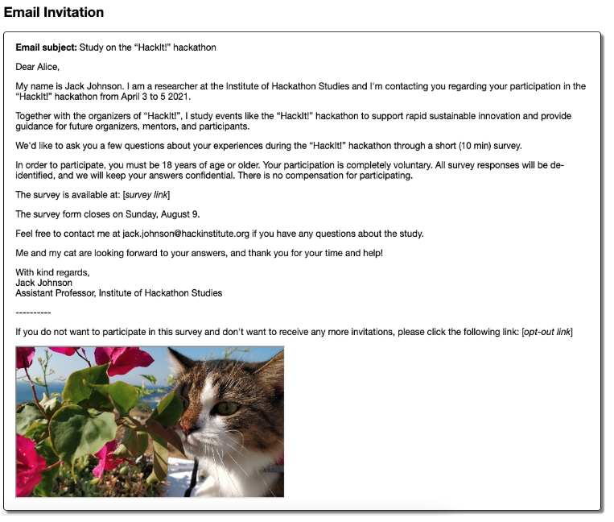
Perceived Relevance
Personalized invitation
What’s the content?
Tailor language and level of formality to target group
Addressing the participant by name
Mention the purpose and relevance of the study
Emphasize credible sponsor/funder
If applicable, reference prior engagements with the individual (e.g., previous surveys, purchases, memberships)
Link the recipient’s background or role to the survey’s purpose
Highlight personal/professional benefits
If applicable, mention incentives
Ensure that data protection regulations are followed and responses are kept confidential
Chounta, I.-A., & Nolte, A. (2022). [Title of specific figure if known] (Figure X) in: The CAT Effect: Exploring the Impact of Casual Affective Triggers on Online Surveys’ Response Rates, Proceedings of CHI ’22. ACM. https://doi.org/10.1145/3491102.3517481
Chounta & Nolte (2022)
Notes:
One of the most important measures to increase your target groups perceived relevance are personalized invitations.
Imagine getting an email that starts with ‘participant’ versus one that says ‘Hi [Your Name], we’d love to hear your thoughts on topic xyz.’ Which one are you more likely to open? The second one, right? That’s the magic of personalization.
Start by addressing the participant by name – in case you know the name of course.
Then, explain why this survey is worth their time. How does it relate to their interests, their work, or their life? Maybe they’ve engaged with your organization before—mention that! For instance, 'As a member of our community' or 'Since you’ve participated in our previous study.’
Credibility is another big deal. Make clear who’s behind the survey. And don’t forget the benefits.
Then highlight why their response is valuable for the success of your study. Will their input help shape a new policy? Advance research? Highlight that! If there are incentives, let them know—but focus on the intrinsic value too.
Finally, reassure them about privacy. Let them know their responses are confidential and that you’re following data protection regulations.
Klick
In this context, I’d like to briefly mention a study that a colleague pointed out to me while preparing for the workshop. Researchers conducted a survey experiment to see how including cat photos in invitation emails for web surveys would impact the response rate—and you probably won’t be surprised to hear that invitations with cat photos led to a significantly higher response rate in the experiment. For those interested in the study, I’ve linked it here.

Slide 64
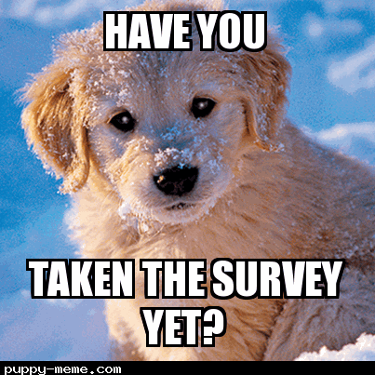
Perceived Relevance
Reminder
What should go inside?
Recognize that the recipient may have seen the earlier invitation but not had time to respond.
Remind participants of the purpose of the survey and its relevance to them
Include the survey link prominently
Create a sense of urgency by specifying the survey’s closing date (last reminder only!)
If offering an incentive, remind participants of the reward and how to claim it.
Provide an email or phone number for participants who have questions or encounter technical issues
@grpcio (2018) Have taken the survey yet? Meme captured using puppy-meme.com. Retrieved July 9, 2025 from https://x.com/grpcio/status/1032398676508008448.
Notes:
Next to invitations, survey reminders are also important to look at. Picture this: your first invitation went out, but life happened. People got busy. They meant to click the link but never did. That’s where your reminder comes in.
What should contain a good reminder?
First, acknowledge the obvious: they might’ve seen your earlier invite but just didn’t have the time to respond yet.
Next, gently remind them why this survey matters—not just to you, but to them. What’s in it for them? Highlight that connection again.
Include the survey link again and highlight it prominently.
Now, if the deadline is close, add a little urgency. And mention the closing date! But its best practice to do it in the last reminder only.
If you’re offering an incentive, remind them about it.
Finally, be accessible. Include a contact email or phone number for any questions or tech issues, so there’s no reason for hesitation.

Slide 65
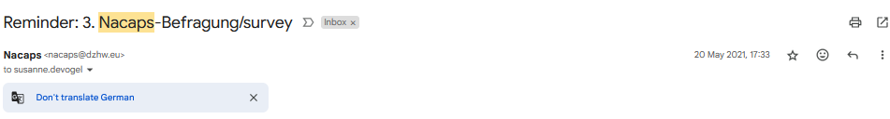
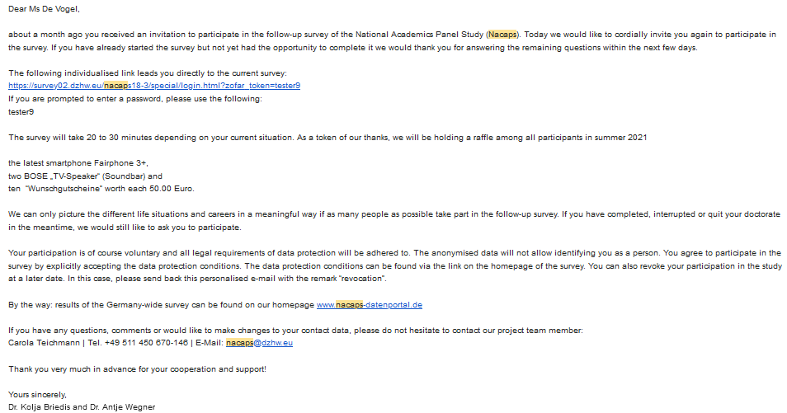
Perceived Relevance
Example
Notes:
Here’s a real-life example of a reminder for our Nacaps survey. Take a moment to look at the structure here.
First, the email starts with a friendly tone, addressing the recipient personally and acknowledging they’ve been invited before. It’s not pushy—it’s polite and encouraging.
The main part of the email highlights the unique survey link. This is so important because it eliminates any extra steps for the respondent. Right below, they’ve included an estimated time to complete the survey. That’s crucial. If people know it’s only going to take, say, 20–30 minutes, they’re much more likely to click through.
Then, it highlights an incentive—a raffle with specific prizes.
And then follows the emphasis on relevance—they explain how the survey connects to the participants’ lives and why their input really matters.
And finally, they’ve provided contact details for questions or concerns, which makes the whole process feel accessible and participant-focused. A reminder like this does it all—kind, clear, and motivating.

Slide 66
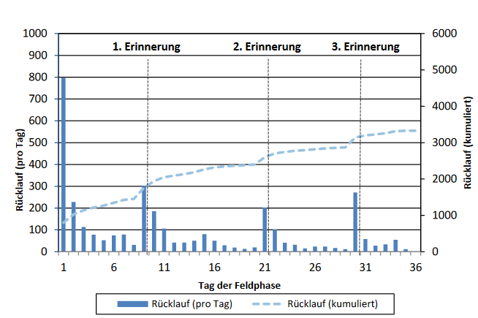
Perceived Relevance
Invitation and Reminder Timing
What to send?
Send 2-3 reminders for most surveys
Space invitation and reminder appropriately to balance encouragement and avoid annoyance
First Reminder: 3-5 days after the initial invitation.
Second Reminder: 7-10 days after the first reminder.
Final Reminder: 1-3 days before the survey deadline; state deadline
1st reminder
2nd reminder
3rd reminder
responses per day
cumulative responses
day of the field phase
responses per day
cumulative responses
Responses in the DZHW PhD Graduate Panel 2014 over time, Wave 2
Brandt et al. (2014). DZHW-Promoviertenpanel 2014 Daten- und Methodenbericht zu den Erhebungen der Promoviertenkohorte 2014 (Befragungswelle 1-5);Version 4.0.0. Hannover: DZHW)
Notes:
So when we are talking about reminders, it’s not just about the content. But it’s also important to talk about how many reminders you should send and what a suitable timing is. So, what’s the golden rule?
Most surveys work best with 2 to 3 reminders. It’s enough to keep participants engaged without overwhelming them.
Timing is everything here. The first reminder typically goes out 3 to 5 days after the initial invitation. Why? Because it gives people time to respond without feeling pressured, but it also catches those who might have forgotten.
Then, we wait another 7 to 10 days before sending the second reminder. This spacing ensures we stay visible without becoming annoying.
And if you’re going for a final push, send the last reminder 1 to 3 days before the survey deadline, and it also helps to mention the closing date of your survey.
Klick
Take a look at the graph. These are the responses of the first Nacaps follow up surveys by day. You’ll see these spikes in responses right after each reminder. This shows how effective good timing can be.

Slide 67


Perceived Relevance
Invitation and Reminder Timing
Which weekdays work best?
What is the best time of the day?
Tuesday, Wednesday, and Thursday are typically the best days to send survey invitations and reminders
On these days, recipients are more likely to have settled into their weekly routine and are less overwhelmed by emails
Morning (9 AM to 11 AM)
Many recipients check their email early in the workday.
Early Afternoon (1 PM to 3 PM)
After lunch, people are often more relaxed and may engage with emails during a break or before diving back into work.
Consider audience’s schedule
For populations like students, elderly people or shift workers, their schedules may not align with traditional workweeks.
Account for time zones
Avoid public holidays/ school holidays
Notes:
Timing isn’t just about when to send reminders—it’s about finding the right spot in the week and the day when your audience is most receptive.
Now, let’s talk weekdays first.
Klick
Generally, Tuesday, Wednesday, and Thursday are your best bets. Why? By Tuesday, they’ve settled into their routines. And by Friday, well, the weekend’s on their minds. Midweek emails are less likely to get buried under a pile of messages.
But here’s the thing: know your audience. The best practices I just mentioned apply to the general population. Are they students who might work odd hours? Elderly participants who prefer mornings? Shift workers with unconventional schedules? These details matter.
And of course, avoid public and school holidays, because people are most likely to take surveys while they are working.
Klick
Which brings us to the time of day. Mornings—between 9 and 11 a.m.—are often golden. People are fresh, just settling in, and checking emails is part of their routine. Another good window is early afternoon, 1 to 3 p.m during or right after their lunch break.
And, don’t forget time zones! What’s perfect timing for you might land in the middle of the night for your participants. Always consider where your audience is and adjust accordingly.

Slide 68
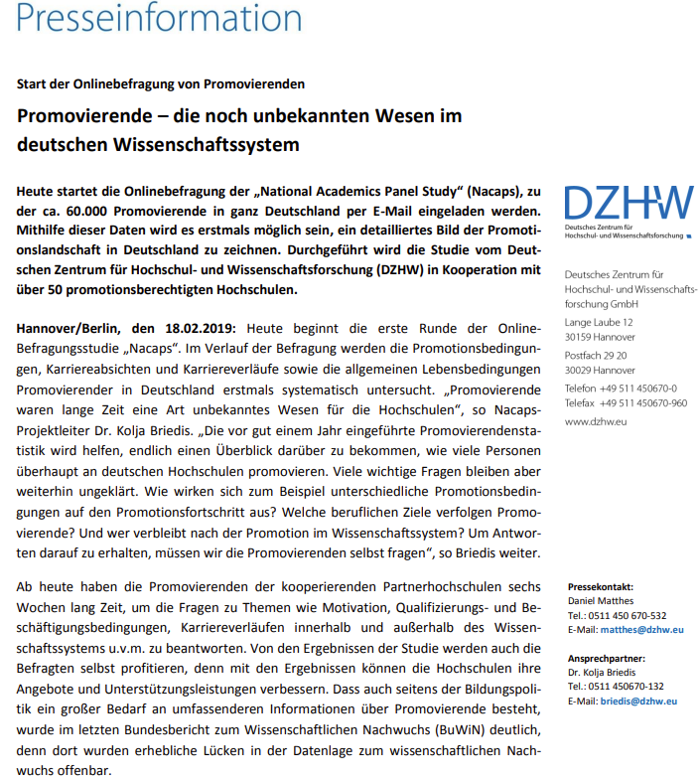

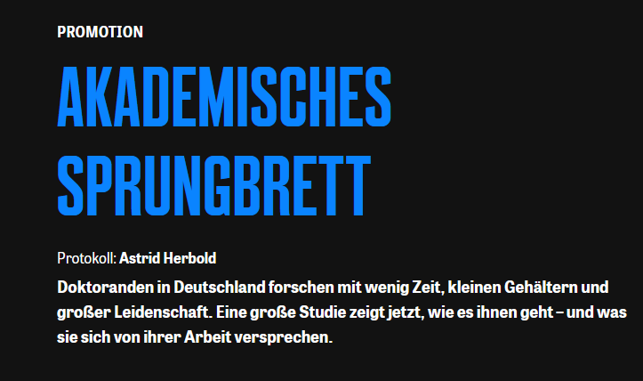
Perceived Relevance
Public relations
Measures to capture attention and communicate the survey’s impact and importance
Press release announcing the survey
Work with local or national media outlets to feature stories about the survey
Collaborate with community groups to introduce the survey and its goals
ZDF. (2023, November 5). MAITHINK X – Die Show: Folge 11. Retrieved July 9, 2025 from https://www.zdf.de/video/shows/mai-think-x-die-show-102/maithink-x-folge-11-100
Die ZEIT (2020) Promotion: Akademisches Sprungbrett. Retrieved December 2, 2024 from https://www.zeit.de/2020/10/promotion-arbeitsbedingungen-wissenschaft-gehalt-doktoranden
DZHW (2023). Wie geht es den Promovierenden in Deutschland? Start der großen Onlinebefragung Nacaps. Presseinformation. Retrieved July 9, 2025 from https://www.dzhw.eu/services/material/pressemitteilungen/2023_02_27_pm_nacaps.pdf
Notes:
Apart from invitations and reminders, another powerful tool is some sort of public relations—this is where we step outside the survey bubble and start building bridges to the world. It’s all about creating attention and demonstrating why this survey matters, not just to us, but to the wider community.
First, thing you can easily do is press releases. They’re a straightforward way to attract attention to your study, whether through local or national media outlets. A well-written press release can spark interest, maybe even lead to a feature article or news segment. The goal is to make people curious and engaged, even before they receive an invitation.
Next, media collaborations. Imagine teaming up with a popular science communicator or getting your survey featured in a podcast relevant to your field. These partnerships can give your survey credibility and expand its reach far beyond your immediate audience. And when their invitation finally comes, your participants may remember your study and are therefore more likely to participate.
And then, partnering with community groups or organizations aligned with your survey’s goals can help you reach the right people, in the right way. Whether it’s through an educational video, a webinar, or a community event, these efforts can make your survey feel relevant and inclusive.
Klick
Here for example, you see a press release about the start of the Nacaps Survey, and following this the study received quite a lot of media attention, e. g. in the Zeit journal, in TV shows and podcasts.

Slide 69


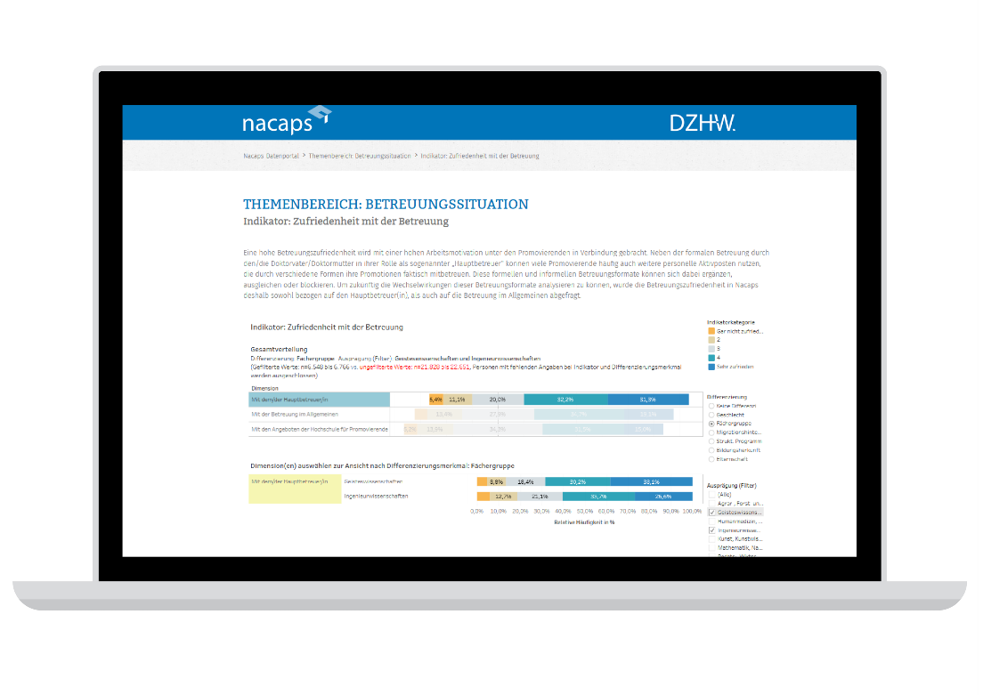

Perceived Relevance
Public relations
Measures to show respondents how their information is utilized and that their efforts make a real contribution (e.g. results, published papers, conference talks, PhD theses) during and after the survey period
Project website
Newsletter
Social media
Data portal
National Academics Panel Study (NACAPS). (n.d.). Home. Retrieved July 9, 2025, from https://www.nacaps.de/en/index_html
National Academics Panel Study (NACAPS). (n.d.). University cooperation partners. Retrieved July 9, 2025, from https://www.nacaps.de/hochschulkooperationen/index_html
NACAPS – National Academics Panel Study. (n.d.). LinkedIn page. Retrieved July 9, 2025, from https://www.linkedin.com/company/nacaps-panel
Notes:
Another goal in public relation is to show participants that their contributions truly matter. People want to know that their time and effort lead to something meaningful. So, you should keep them informed and engaged.
First, you can set up a dedicated project website. It’s a place where participants can go to learn more about the project, see updates, and maybe even read about preliminary findings. It’s also a great way to demonstrate transparency and credibility.
Newsletters are another fantastic tool. You can use them to share results, highlight how the data is being used, or even showcase stories of impact—like how the findings influenced a policy decision or contributed to academic work.
Social media—this is where we can really connect with a broader audience. Whether it’s through posts, stories, or tweets, you can share little updates, interesting facts from your survey, introduce your team, or even engage in dialogue with followers, for example through LinkedIn.
And finally, data portals. These are a bit more advanced, but they are super cool for sharing results participants or stakeholders. By giving people access to aggregated data or interactive tools, you’re not just sharing results—you’re enabling further research and impact. For example, in Nacaps we set up a data portal using the tableau software and created a public and a closed access area, where people can do small analyses themselves.

Slide 70

Participant Motivation and Incentivization
Factors influencing motivation
Perceived relevance
Ease of participation
Participants are more motivated if they feel the survey is relevant to their lives or interests.
Respondents are more motivated when they feel that their experien-ces make an important contribution.
A high response burden may reduce motivation
Notes:
When it comes to motivation in surveys, the next important aspect is the ease of participation.
Nobody likes a survey that’s overly long, confusing, or filled with technical glitches. High response burden will turn people away. The easier and more seamless the survey experience, the more likely they’ll stick with it till the end. Let’s talk about what to consider.

Slide 71

Ease of Participation
Response burden
Response burden refers to the perceived effort, time, and complexity that respondents experience when completing a survey.
A high response burden can negatively affect the data quality:
Lower response rates/ high drop-out
Incomplete responses
Inaccurate or random answers
Bias (e.g. only highly motivated people respond)
Keep that response burden low ☺
@betweenwalks (n.d.). "I’ve been carrying a heavy burden..." Comic. Retrieved June 25, 2025, from https://www.instagram.com/betweenwalks. Used for non-commercial educational purposes.
Notes:
Response burden, which refers to the perceived effort, time, and complexity that respondents feel when completing a survey. Basically, the more of a ‘burden’ the survey feels like, the more likely we are to lose people along the way.
A high response burden can really impact our data quality. First, it can lower response rates or lead to high dropout rates, as people might feel overwhelmed and just stop halfway through. We also risk getting incomplete responses if participants start skipping questions. If the survey feels too hard, people might just rush through with random answers. And if only highly motivated people stick around to complete it, we’re left with a biased sample that might not reflect the broader population.

Slide 72
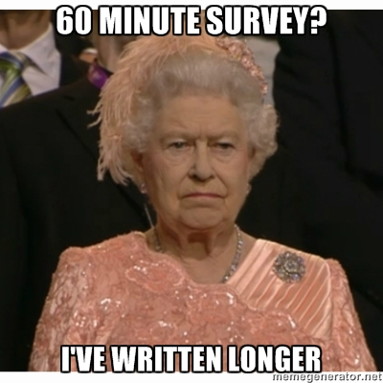
Ease of Participation
Three types of response burden
Time burden
Time it takes to complete the survey
Questions relevant for project and respondent
Survey short and concise (<15 min.)
Pettit, A. (n.d.). Survey unimpressed Queen meme. Retrieved June 25, 2025, from https://lovestats.wordpress.com/dman/survey-research-statistics-meme/survey-unimpressed-queen-meme/
Notes:
When we talk about response burden, it’s helpful to break it down into three types: time burden, cognitive burden, and emotional burden.
Time burden is the simplest to understand—it’s the actual time it takes to complete the survey. If it feels too long, respondents might lose patience or drop out entirely.

Slide 73
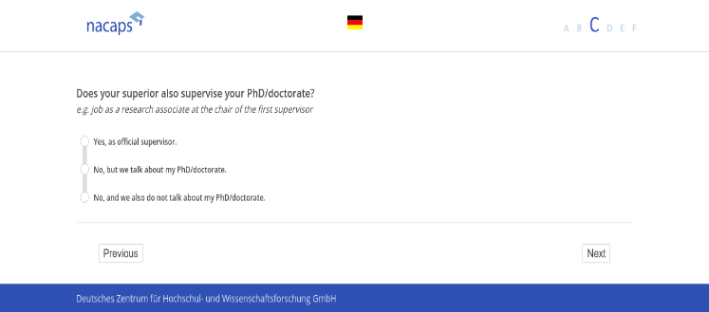
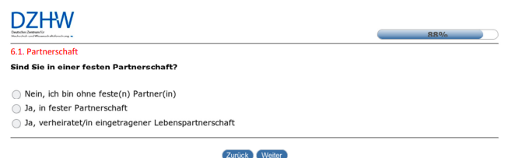
Ease of Participation
Survey length and completion time
Online respondents may have short attention spans, so it’s crucial to make the survey short and concise
Only questions relevant to them
Keep the survey as short as possible (ideally under 15 minutes)
Provide an estimated completion time at the beginning to set expectations (be honest!)
Prioritize key questions and place more important questions early in the survey
Provide a progress bar so respondents know how far along they are
Use filtering and/or split-half methods
German Centre for Higher Education Research and Science Studies (2024). National Academics Panel Study (Nacaps) 2018 - Survey 1. Data collection: 2019. Hanover: FDZ-DZHW. https://doi.org/10.21249/DZHW:nac2018:2.0.0. Questionnaire "Nacaps 2018. Variable Questionnaire for National Academics Panel Study 2018 (1st wave - doctoral candidates) (English) ". Question C1.
German Centre for Higher Education Research and Science Studies (2024). DZHW PhD Panel 2014 - Survey 3. Data collection: 2017. Hanover: FDZ-DZHW.10.21249/DZHW:phd2014:4.0.0. Questionnaire “Karrieren Promovierter” (3rd wave - German)". Question 6.1
Notes:
From survey research, we know that respondents' attention spans are especially short during online surveys. So you need to manage survey length and completion time.
First off, keep it short and to the point. Ideally, aim for under 15 minutes. Long surveys can lead to drop-offs, so stick to what’s essential.
Let respondents know the estimated completion time right at the beginning. This small detail sets expectations, and it’s best to be honest – nothing frustrates participants more than thinking it’ll be quick only to find out it’s much longer.
Prioritize key questions by placing the most critical ones early in the survey. This way, even if someone doesn’t finish, you still capture the core information.
A progress bar is another great addition. It’s a visual cue that lets respondents see how far along they are, which can motivate them to keep going. In this example, you see an example of two progress bar. You can either do it as a progress bar in percentage of the questionnaire, or you do it indirectly via dividing the questionnaire into thematic blocks indicating in which block they are. What do you think may be issues with these kind of progress bars?
Finally, if there are really a lot of questions necessary, consider using filtering or split-half methods. Filtering directs respondents to relevant sections, reducing the time spent on irrelevant questions. Split-half methods allow you to divide longer surveys, so each respondent only answers a subset of questions, but you still get a full data set across participants.

Slide 74
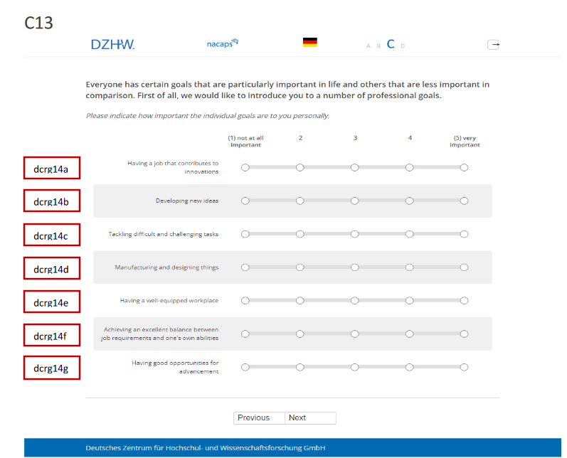
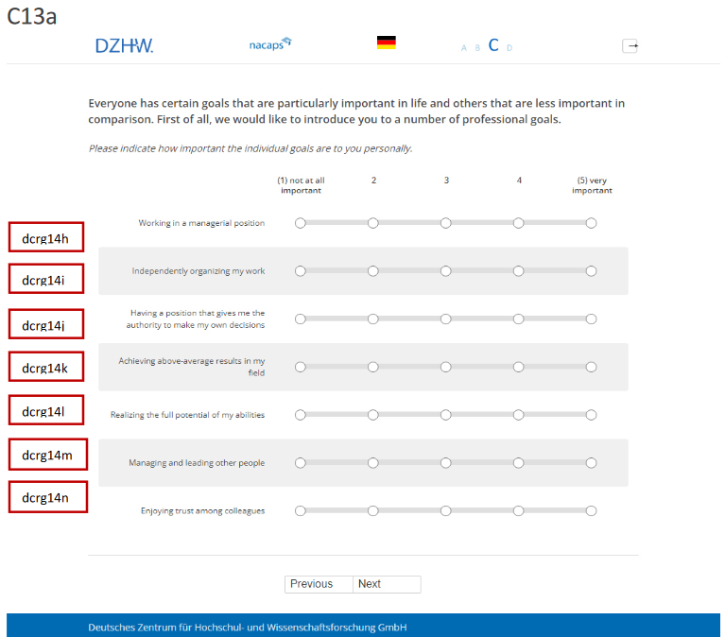
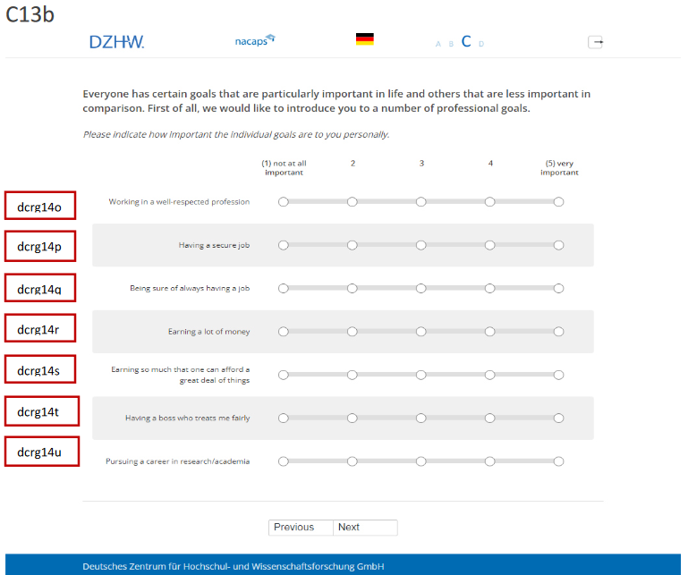
Ease of Participation
Three types of response burden
Time burden
Time it takes to complete the survey
Cognitive burden
Mental effort required to understand and answer the questions
Use simple and clear language, avoid technical jargon, appropriate to target group, provide instructions
No repetitive or redundant questions
Clear, responsive, barrier-free layout
Questionnaire follows logical flow
Questions relevant for project and respondent
Survey short and concise (<15 min.)
Pettit, A. (n.d.). Survey unimpressed Queen meme. Retrieved June 25, 2025, from https://lovestats.wordpress.com/dman/survey-research-statistics-meme/survey-unimpressed-queen-meme/
German Centre for Higher Education Research and Science Studies (2024). National Academics Panel Study (Nacaps) 2018 - Survey 4. Data collection: 2022. Hanover: FDZ-DZHW. https://doi.org/10.21249/DZHW:nac2018:2.0.0. Questionnaire "Nacaps 2018. Variable Questionnaire for National Academics Panel Study 2018 (4th wave - doctoral candidates) (English) ". Question C13-C3B.
Notes:
Then we have cognitive burden, which is the mental effort required to understand and answer questions. So what can you do to keep cognitive burden low?

Slide 75
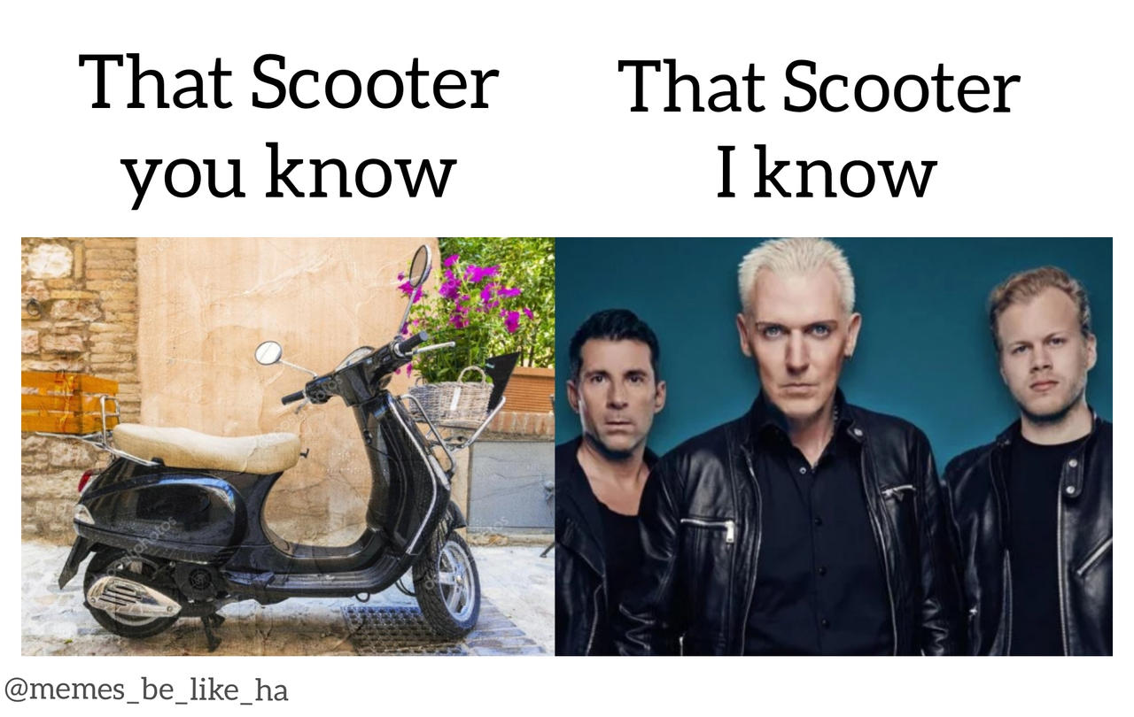
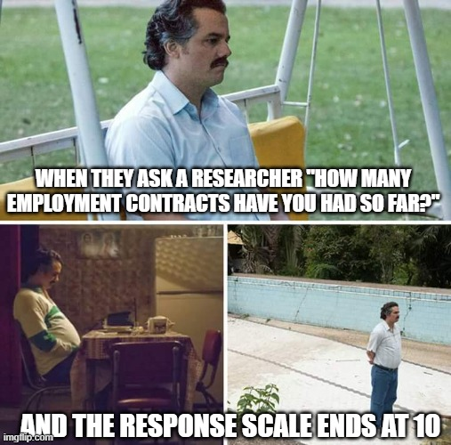
Ease of Participation
Clear and concise questions
Questions must be simple and clearly worded
HeroXD (2019). Scooter and Scooter MEME. Retrieved June 25, 2025, from https://www.deviantart.com/heroxd/art/Scooter-and-Scooter-MEME-793711534. Used for non-commercial educational purposes.
Screenshots from Narcos (Netflix, Gaumont International Television). Meme created using imgflip.com. Retrieved June 25, 2025. Used for non-commercial educational purposes.
Provide clear instructions
Questions should be culturally appropriate and contextually relevant
Relevant and exhaustive response options
Notes:
When we’re designing questions, there are a few essentials we need to keep in mind to get accurate information. Let’s start with the basics
Klick
First, cultural and contextual relevance. Cultural references and assumptions can vary. We need to make sure our questions are relevant and appropriate for all respondents, especially in diverse samples.
Klick
Next, questions must be clearly worded. This sounds simple, but it’s easy to accidentally use jargon or ambiguous language. Clear wording helps prevent misunderstandings and ensures everyone interprets the question in the same way.
Klick
Equally important is providing clear instructions. If there’s any ambiguity about how to respond, it could lead to inconsistencies in the data we collect.
Klick
Finally, relevant and exhaustive response options. The meme here perfectly captures the importance of this. In Nacaps, we asked the respondents about how many working contracts they have had so far, and we got a lot of feedback from the respondents how our question was problematic because the response options we offered ended at ten. But in science, people can easily have more than ten working contracts during their career. So that was definitely a learning experience. So if we’re asking about something like the number of employment contracts – same happened to the number of children by the way - we need to ensure our scale covers the full range. Otherwise, we’re limiting respondents’ ability to give accurate answers, which can skew our data.

Slide 76
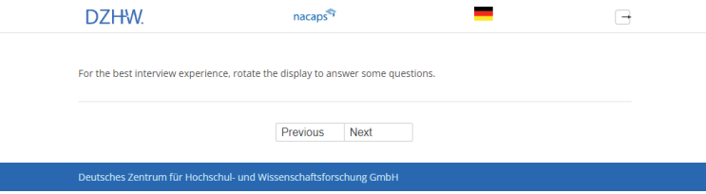
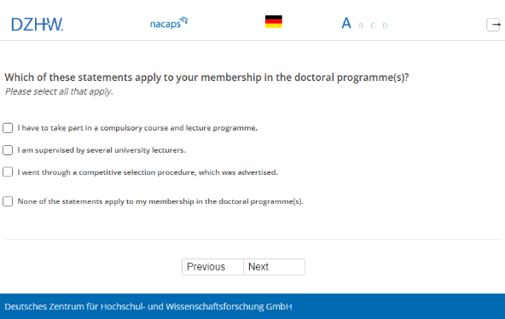
Ease of Participation
Instructions
How to administer the questionnaire
language
recommended devices
German Centre for Higher Education Research and Science Studies (2024). National Academics Panel Study (Nacaps) 2018 - Survey 4. Data collection: 2022. Hanover: FDZ-DZHW. https://doi.org/10.21249/DZHW:nac2018:2.0.0. Questionnaire "Nacaps 2018. Variable Questionnaire for National Academics Panel Study 2018 (4th wave - doctoral candidates) (English) ". Offer page.
How to answer each questions
optional/ required questions
Allowed input formats, value ranges
Single/multiple choice
German Centre for Higher Education Research and Science Studies (2024). National Academics Panel Study (Nacaps) 2018 - Survey 4. Data collection: 2022. Hanover: FDZ-DZHW. https://doi.org/10.21249/DZHW:nac2018:2.0.0. Questionnaire "Nacaps 2018. Variable Questionnaire for National Academics Panel Study 2018 (4th wave - doctoral candidates) (English) ". Question A15.
Notes:
Clear, simple, and upfront instructions can really reduce frustration and dropouts.
Klick
First, let participants know how they should administer the survey: what language the survey is in and which devices work best.
On the right, you see an example that includes a reminder for respondents to rotate their display to improve the survey experience.
Klick
Next, guide them through answering each questions. Because there is no interviewer present to help them with unclear questions. Let them know what’s optional versus required and what kind of answers are expected—whether they’re typing a number, ticking a box, or selecting multiple options. For instance, is this a single-choice question or a ‘select all that apply’ type? Be specific like in this example over here.

Slide 77
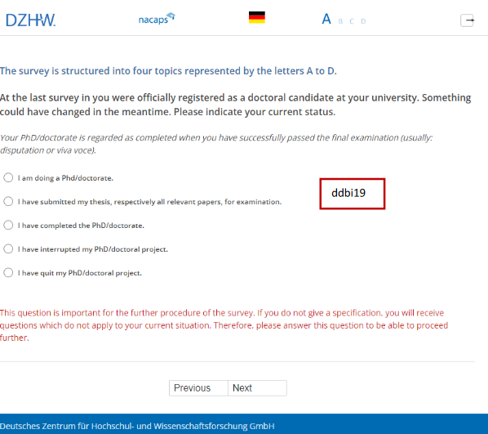
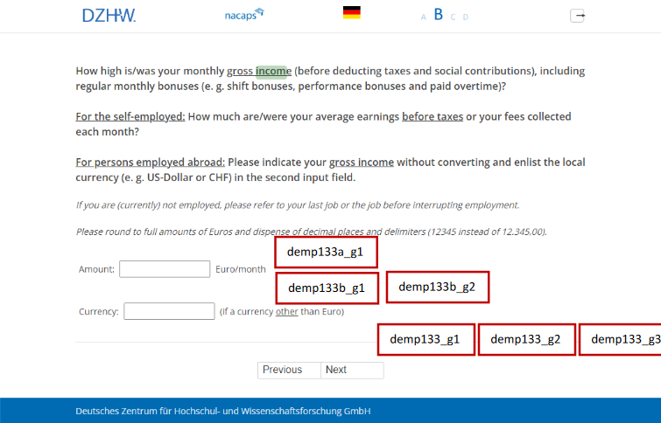

Ease of Participation
More instructions….
German Centre for Higher Education Research and Science Studies (2024). National Academics Panel Study (Nacaps) 2018 - Survey 4. Data collection: 2022. Hanover: FDZ-DZHW. https://doi.org/10.21249/DZHW:nac2018:2.0.0. Questionnaire "Nacaps 2018. Variable Questionnaire for National Academics Panel Study 2018 (4th wave - doctoral candidates) (English) ". Questions A01 + B17.
Notes:
Here you can see two more examples. The first shows instructions on how the questionnaire is divided into thematic blocks, explanations for a specific question, and a note that answering this question is necessary to proceed with the questionnaire.
Klick
On the right, there’s an example with information about the valid value range.

Slide 78
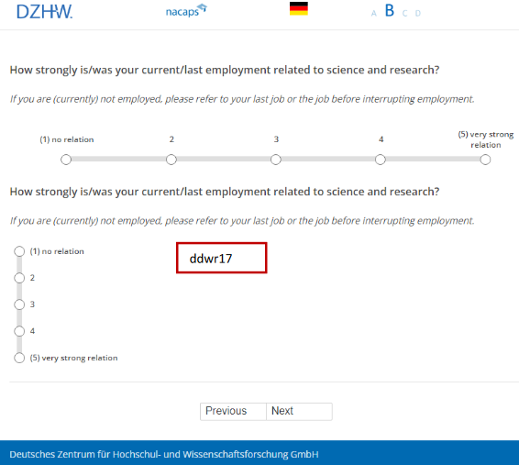
Ease of Participation
Responsive design
Many respondents will use mobile devices, so the survey should be optimized to navigate with different devices.
Ensure the survey is responsive and adjusts well to different screen sizes.
Avoid complex question formats, like drag-and-drop, which may not work well on mobile devices.
Test the survey on multiple devices and browsers before launch
German Centre for Higher Education Research and Science Studies (2024). National Academics Panel Study (Nacaps) 2018 - Survey 4. Data collection: 2022. Hanover: FDZ-DZHW. https://doi.org/10.21249/DZHW:nac2018:2.0.0. Questionnaire "Nacaps 2018. Variable Questionnaire for National Academics Panel Study 2018 (4th wave - doctoral candidates) (English) ". Question B34.
Notes:
Next, let's talk about responsive design. In today’s world, many respondents will complete surveys on mobile devices, so it’s crucial to ensure that your survey is optimized for different screen sizes.
In the example here, you see how this question is optimized for different screen sizes. The response scale is horizontal for wide screens, and shifts to vertical when using narrower displays like mobile phones.
Make sure the survey adjusts smoothly on both small screens like phones and larger screens like tablets or desktops. The layout should remain user-friendly across devices.
Try to steer clear of complex question formats like drag-and-drop or highly interactive components, as these might not work well on all devices, particularly on mobile.
Always test your survey on multiple devices and browsers to catch any potential issues before launching.

Slide 79

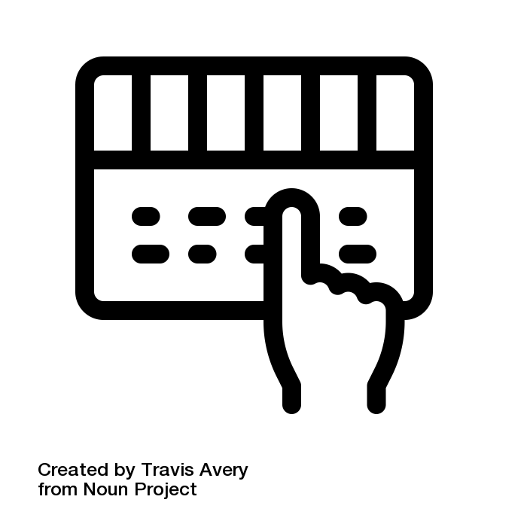
Ease of Participation
Accessibility
To reach a broad audience, online surveys should be accessible to individuals with disabilities
Use keyboard navigation, alt text for images, and appropriate colour contrast
Test the survey for compatibility with screen readers and other assistive technologies
Avoid complex elements like timed questions
Notes:
Accessibility is key to making sure our surveys can reach and be used by everyone, including respondents with disabilities. When designing an online survey, there are a few critical things to keep in mind:
The survey should be fully navigable using a keyboard, and all images need descriptive alt text for those using screen readers.
Ensure the colors have appropriate contrast, so text is easy to read, even for people with visual impairments.
Test the survey with screen readers and other assistive technologies to ensure compatibility.
Elements like timed questions can be challenging for users with certain disabilities, so it’s best to avoid those.

Slide 80
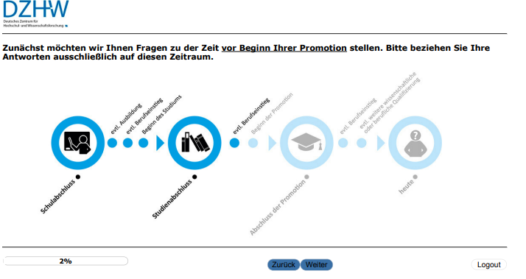
Ease of Participation
Logical flow of questions
Group related questions and avoid jumps in topics
Provide transition statements
Use filter questions
DISCLAIMER: The more extensive and complex the filtering, the more time-consuming the data processing
Start with easy questions or a catchy icebreaker
Move from general to more specific questions
German Centre for Higher Education Research and Science Studies (2024). DZHW PhD Panel 2014 - Survey 2. Data collection: 2016. Hanover: FDZ-DZHW.10.21249/DZHW:phd2014:4.0.0. Questionnaire “Karrieren Promovierter” (2nd wave - German)".
Notes:
After we’re talking about the general structure of the questionnaire, I want to move on to creating a logical flow of questions in a survey.
When questions are organized by topic and don’t jump around randomly, it’s much easier for respondents to stay focused. It also helps them to answer each question in the right context. For example, if we have a series of questions on a particular theme, it’s best to keep them together to build a clear narrative flow.
Use transition statements to announce topic changes or to clarify what the following questions are referring to. Like in this example over her from the PHD Panel Survey.
Filter questions allow respondents to skip sections that aren’t relevant to them. This not only makes the questionnaire shorter for some participants but also tailors it to each individual’s experience. Just a note of caution: complex filtering can make data processing more time-consuming, so it’s essential to strike a balance.
It’s a good idea to start the questionnaire with simple or engaging questions. These act as icebreakers and help motivate respondents to keep going. People tend to lose interest if they’re hit with difficult or sensitive questions right at the start. In the example, you see the first question of the PhD Graduate Panel survey we just included for icebreaker purposes.
Begin with broad questions and gradually narrow down to more specific ones. This helps respondents ease into the topic and feels more natural as they progress through the questionnaire.

Slide 81
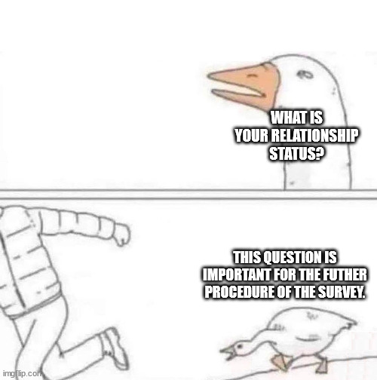

Ease of Participation
Three types of response burden
Time burden
Time it takes to complete the survey
Cognitive burden
Mental effort required to understand and answer the questions
Emotional burden
Emotional strain or discomfort experienced
by respondents
Use simple and clear language, avoid technical jargon, appropriate to target group, provide instructions
No repetitive or redundant questions
Clear, responsive, barrier-free layout
Questionnaire follows logical flow
Use sensitive and respectful language
Provide purpose
Assure data protection and confidentiality
Allow skipping questions
Questions relevant for project and respondent
Survey short and concise (<15 min.)
Pettit, A. (n.d.). Survey unimpressed Queen meme. Retrieved June 25, 2025, from https://lovestats.wordpress.com/dman/survey-research-statistics-meme/survey-unimpressed-queen-meme/
German Centre for Higher Education Research and Science Studies (2024). National Academics Panel Study (Nacaps) 2018 - Survey 4. Data collection: 2022. Hanover: FDZ-DZHW. https://doi.org/10.21249/DZHW:nac2018:2.0.0. Questionnaire "Nacaps 2018. Variable Questionnaire for National Academics Panel Study 2018 (4th wave - doctoral candidates) (English) ". Question C13-C3B.
Meme based on the “angry goose” comic meme format. Edited and captioned via imgflip.com (accessed June 25, 2025).Original artist unknown. Used for non-commercial educational purposes.
Notes:
Back to response burden: Last is emotional burden.
This is about the discomfort or sensitivity respondents might feel with certain questions.

Slide 82
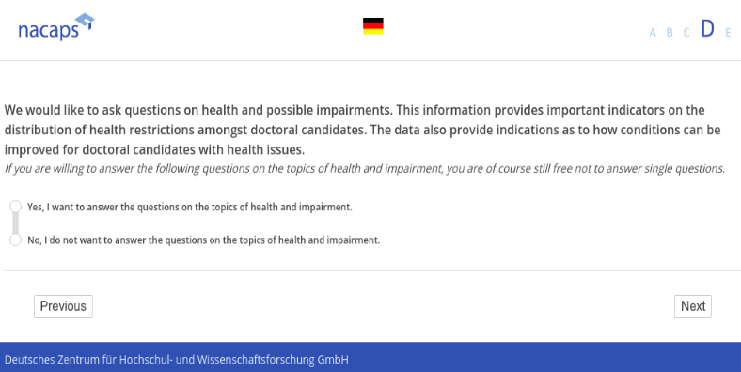
Ease of Participation
Ethical research
Assess questions for any topics that may be sensitive, intrusive, or distressing
Use neutral, non-judgmental wording
Place sensitive questions later in the questionnaire
Provide a trigger warning and a skip option or “prefer not to answer” response for sensitive questions
Avoid language that might alienate or marginalize certain populations
Review language and content for cultural relevance and appropriateness
Use professional translators familiar with cultural nuances to maintain the original meaning
German Centre for Higher Education Research and Science Studies (2024). National Academics Panel Study (Nacaps) 2018 - Survey 1. Data collection: 2019. Hanover: FDZ-DZHW. https://doi.org/10.21249/DZHW:nac2018:2.0.0. Questionnaire "Nacaps 2018. Variable Questionnaire for National Academics Panel Study 2018 (1st wave - doctoral candidates) (English) ". Question D14.
Notes:
To keep the emotional burden low, you need to create your survey with ethics in mind.
First, comb through every single question. Are there any that might feel intrusive or distressing? If yes, flag them for careful handling.
Now, how we word these questions matters immensely. Neutral, non-judgmental language is key. For instance, instead of asking something that implies blame or judgment, frame it as objectively as possible.
And timing is everything—place the more sensitive questions later in the survey. By then, the participant is already engaged and may feel more comfortable.
Also, offer a clear out—a trigger warning or a skip option, like 'prefer not to answer.’ – like in this example for health related questions over here.
Watch out for language that could alienate or marginalize groups. Words carry weight, and they can make or break your participant’s experience.
Finally, when your survey crosses cultural or linguistic borders, invest in professional translators who understand the cultural nuances.

Slide 83

Participant Motivation and Incentivization
Factors influencing motivation
Perceived relevance
Ease of participation
Trust in researcher
Participants are more motivated if they feel the survey is relevant to their lives or interests.
Respondents are more motivated when they feel that their experien-ces make an important contribution.
A high response burden may reduce motivation
Trust in the organi-zation conducting the survey and assurances of confidentiality can boost participation
Notes:
Alright, let’s wrap up these factors that influence motivation. We’ve already talked about perceived relevance and ease of participation, but let’s dive into a big one—trust.
Trust in the researcher and the organization behind the survey can make or break participation rates: when participants feel confident that their responses are in good hands, they’re much more likely to engage.

Slide 84

Trust in Researcher
Research Team and Organization
Introducing the research team and the involved organizations provides clarity that a serious research project is behind the survey.
Knowing a name and face associated with the study builds trust regarding who is processing their data
Mention organization, project, principal investigator, and contact details in the invitation and on the survey index page
Provide detailed information about organization and research team on the project website or social media posts
Make invitation look serious and official
National Academics Panel Study (NACAPS). (n.d.). Project Team. Retrieved July 9, 2025, from https://www.nacaps.de/en/team/index_html
Notes:
Let’s talk about the importance of showing the human side of your research. When respondents know who is behind the survey, it adds a layer of trust and transparency.
When you see a name, a face, or an organization that feels credible, it reassures you that your data is in good hands.
Make it clear that this is a serious project with accountable people running it. Mention the organization, the principal investigator, and provide contact details—whether it’s in the survey invitation and on the survey's landing page, or on the project website.
It’s also worth considering to provide additional context about the team or the research objectives on your website or social media address – like in this example over here.
Lastly, make your invitation look legitimate and official. Choose a serious looking email address for your survey, have a proper signature. And if you mail invitations via post, use letterhead and envelopes from the university.

Slide 85
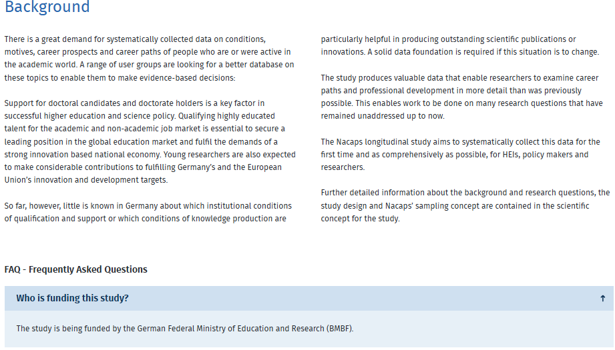

Trust in Researcher
Sponsor/Funder
Naming a reputable sponsor (e.g., a government agency, university, or well-known organization) assures participants that the survey is legitimate and not spam or a scam.
Openly sharing who is behind the survey makes participants feel more secure about how their data will be used
Name sponsor or funder in invitation
PRO TIP: If possible, attach some kind of support letter or statement
National Academics Panel Study (NACAPS). (n.d.). The Study. Retrieved July 9, 2025, from https://www.nacaps.de/en/studie/index_html
Notes:
Another source of trust may come from a recognizable and reputable sponsor or funder. When people see that a government agency, a well-known university, or a respected organization is funding your survey, it immediately communicates legitimacy. It says, 'This isn’t spam or a scam; it’s a serious research project.'
Always name the sponsor or funder clearly in your invitation. Let participants know who is supporting the study—it reassures them that their data is being handled responsibly.
And here’s a pro tip: if you have an opportunity, attach a letter of support or a formal statement from the sponsor. We did this once for the PhD Graduate Panel and it made a highly huge difference in response rates.

Slide 86


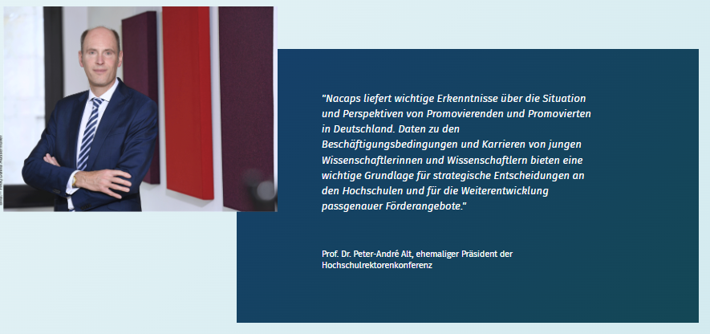
Trust in Researcher
Testimonials
Testimonials from peers or respected figures reassure them that the survey is legitimate and worthwhile.
Individuals in the target audience group
Experts or stakeholders
Researchers or organizers
Advocates
German Centre for higher Education Research and Science Studies (DZHW). (n.d.). Promoviertenpanel. Home. Retrieved July 9, 2025, from https://www.pomoviertenpanel.de
National Academics Panel Study (NACAPS). (n.d.). Home. Retrieved July 9, 2025, from https://www.nacaps.de/en/index_html
Notes:
Testimonials can be incredibly powerful when it comes to building trust and encouraging participation in your survey.
You want to draw testimonials from individuals who resonate with your audience. For instance, peers in the same demographic group as your respondents can make the survey feel more relatable and relevant.
Experts or stakeholders, like leaders in a professional association or academic field, add credibility and weight. And don’t overlook researchers or organizers—they can speak directly to the purpose behind the study.
I have two examples there.
Klick
In the PhD Graduate Panel survey, we mainly worked with real PhD graduates as testimonials for our website. This were mostly coworkers or partners of coworkers.
Klick
A second example is from Nacaps. Here, its more like a mix. We have testimonials from higher education policy, the university administration, representatives of doctoral candidates' interests, and also from researchers who want to work with the data.

Slide 87
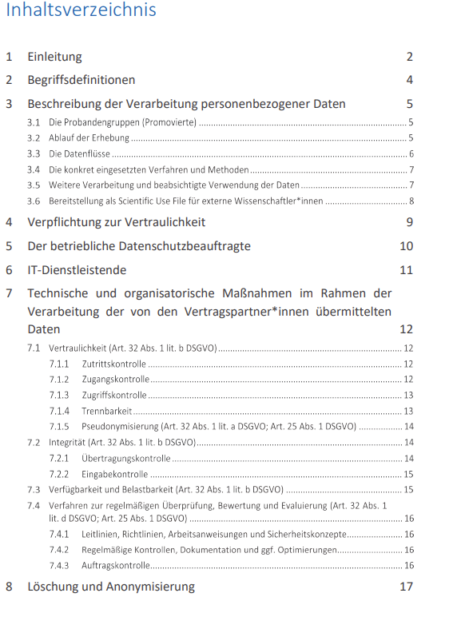

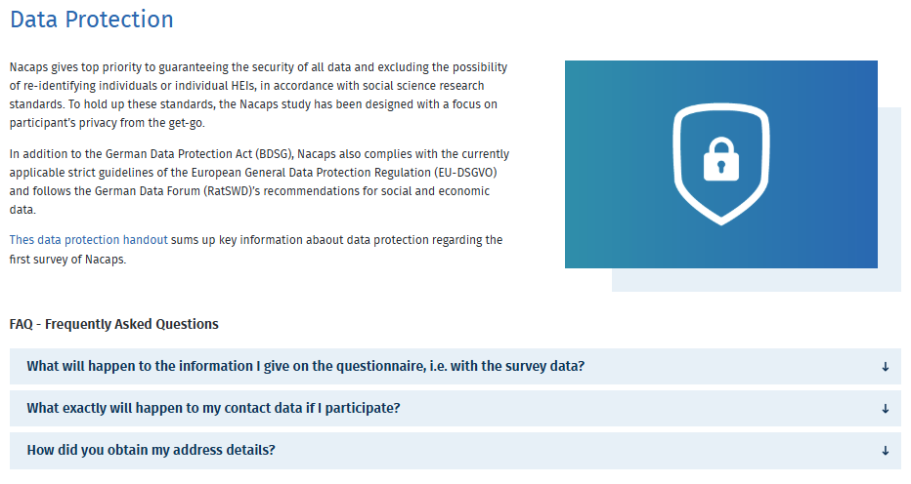
Trust in Researcher
Data protection
Assure that the survey is compliant with GDPR
Information on website with FAQs
Data protection and security concept
National Academics Panel Study (NACAPS). (n.d.). Participation. Retrieved July 9, 2025, from https://www.nacaps.de/en/teilnahme/index_html
National Academics Panel Study (Nacaps) (n. d.) Datenschutz und Sicherheitskonzept. Retrieved July 9, 2025 from https://www.nacaps.de/files/downloads/nacaps_informed_consent.pdf
Notes:
Data protection is an essential part of building trust in researchers, and for good reason—participants need to feel confident that their information is safe. This goes beyond just following legal requirements; it’s about building trust and demonstrating that their privacy matters to you.
If your survey involves participants in the EU or collects data from there, GDPR is non-negotiable.
Klick
Clearly communicate this on your survey website or FAQs. Write what happens to their data, how it’s stored, and what rights they have—think transparency here.
Klick
Another good idea is to have a well-documented data protection and security concept, like in this example from Nacaps here. Here we explained all the measures in detail, whether it’s anonymizing responses or restricting access to sensitive information, and put this available as a download on the project website.

Slide 88
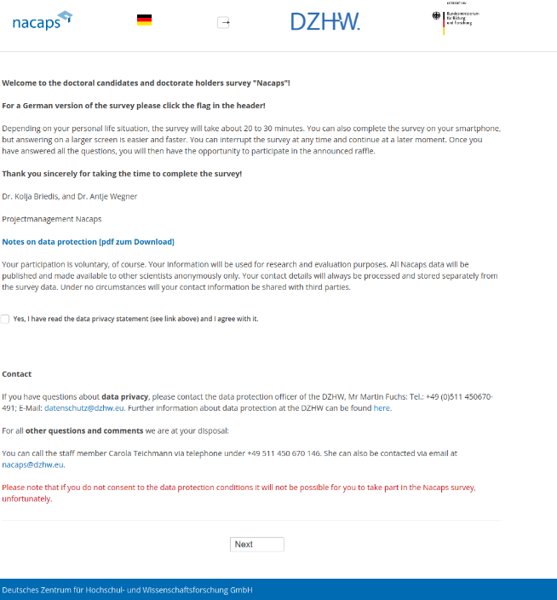
Trust in Researcher
Data protection
Assure that the survey is compliant with GDPR
Information on website with FAQs
Data protection and security concept
Informed consent
German Centre for Higher Education Research and Science Studies (2024). National Academics Panel Study (Nacaps) 2018 - Survey 4. Data collection: 2022. Hanover: FDZ-DZHW. https://doi.org/10.21249/DZHW:nac2018:2.0.0. Questionnaire "Nacaps 2018. Variable Questionnaire for National Academics Panel Study 2018 (4th wave - doctoral candidates) (English) ". Index page.
Notes:
A third important measure in this regard is of course the informed consent part on the index page of your survey.
This is where the legally required data protection terms are clarified, and respondents are asked to provide their consent for data processing, without which they cannot begin the survey.
But I will talk more about it in a few minutes when we discuss data protection.

Slide 89

Participant Motivation and Incentivization
Factors influencing motivation
Perceived relevance
Ease of participation
Trust in researcher
Incentives
Participants are more motivated if they feel the survey is relevant to their lives or interests.
Respondents are more motivated when they feel that their experien-ces make an important contribution.
A high response burden may reduce motivation
Trust in the organi-zation conducting the survey and assurances of confidentiality can boost participation
Individuals are more likely to participate in the survey when participation has a perceived benefit for them.
Notes:
We’ve now covered perceived relevance, ease of participation, and trust in researcher. Lets make it complete in talking about incentives.
Incentives are a great way to boost participation—they give respondents that extra nudge by offering something in return for their time.

Slide 90

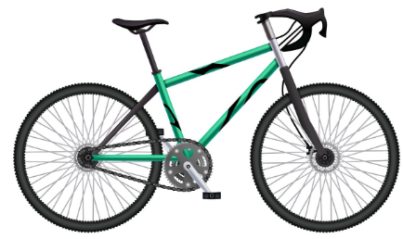


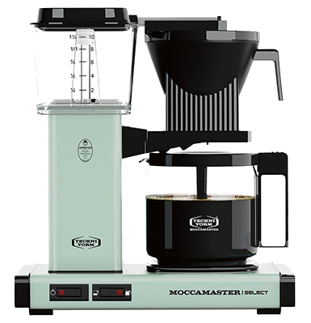

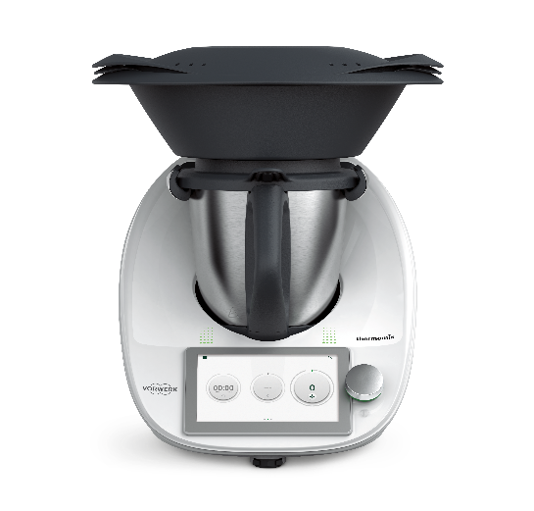






Participant Motivation and Incentivization
Incentives
www.bahn.de
Rewards or compensations offered to participants to encourage them to take part in a survey.
www.popmart.com
www.freepik.de
us.moccamaster.com
www.aida.de
Incentivization strategies
Monetary incentives
Non-monetary incentives
Prize-draws
www.logiway.de
www.freepik.de
www.lindt.de
www.freepik.de
www.vorwerk.com
Notes:
Incentives play a key role in encouraging participation in surveys. They can take different forms, like monetary rewards, non-monetary items such as vouchers or small gifts, or even prize draws for larger items.

Slide 91



Participant Motivation and Incentivization
Monetary incentives
Direct Payments
Gift cards and vouchers
Pay-per-Response
Pros and Cons
Appealing for most audiences
Particularly effective for long or complex surveys
High costs
Pros and Cons
Convenient and appealing to a broad demographic
Allows flexibility in how the reward is used
High costs
Pros and Cons
Cost-efficient for high-volume, low-burden surveys.
Rapid data collection.
May attract "profession-nal survey-takers" who provide low-quality responses
Best for
Short surveys
Time-sensitive studies
Best for
Surveys targeting general populations
When providing direct cash is not feasible
wunschgutschein.de
Best for
High-volume research
A/B testing
Notes:
First, lets talk about monetary incentives. Monetary incentives are a popular and effective way to motivate survey participation. Let's break down three common approaches:
Klick
Direct Payments: These are straightforward cash payments to participants. They’re widely appealing and particularly effective for longer or more complex surveys that demand more time or effort. The downside is that they can be quite costly. These are best used for shorter surveys or when time is critical.
Klick
Gift Cards and Vouchers: These offer flexibility, allowing recipients to choose how they use their reward. They’re appealing to a broad audience, making them a versatile option. However, like direct payments, they come with a significant cost. They work well when direct cash isn't feasible or when your survey targets a general population.
Klick
Pay-per-Response Models: Services like Amazon Mechanical Turk or Trendfrage pay participants for each response. These can be cost-effective for surveys with a large volume of respondents or low response burden. However, there's a risk of attracting 'professional survey-takers,' which may compromise data quality. This method is best for high-volume studies or specific tasks like A/B testing.

Slide 92
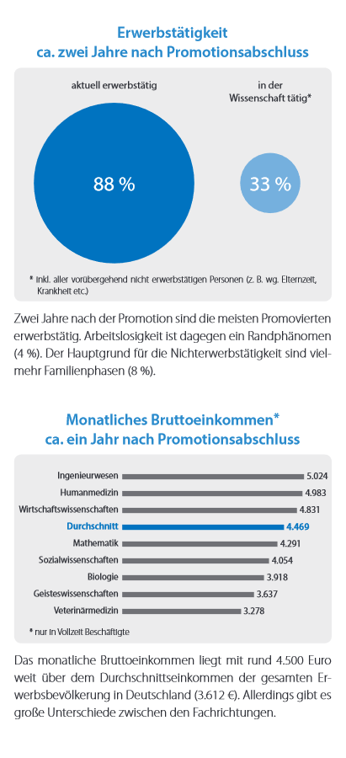
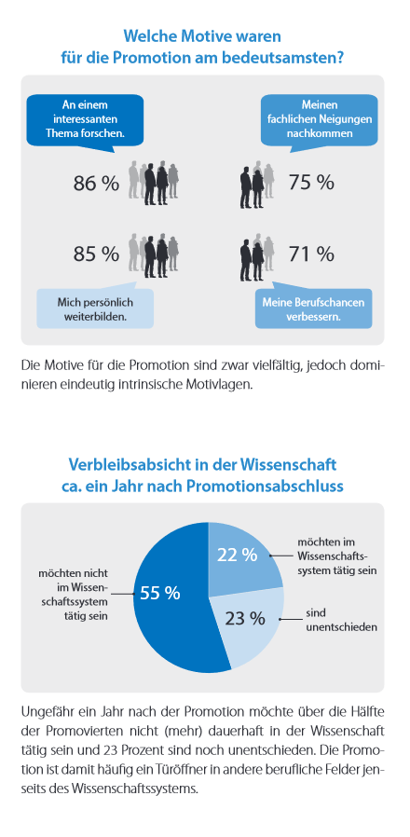
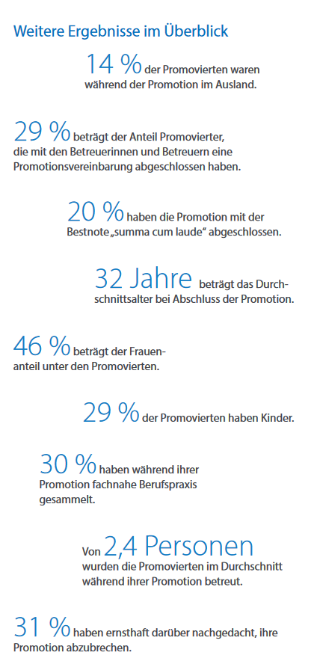

Participant Motivation and Incentivization
Non-monetary incentives
Access to survey results or reports
Charitable donations made on behalf of participants
Pros and Cons
Cost-effective
Builds engagement and goodwill
Not as effective for some target groups
Pros and Cons
Enhances the survey’s alignment with a greater cause
Choice of organization may deter some participants
Best for
Participants who value knowledge or are invested in the survey topic.
Academic surveys, professional studies
Best for
Surveys targeting altruistic and socially conscious groups populations
German Centre for Higher Education Research and Science Studies. (2022). Ergebnisflyer Promovierte PjG 2014. Retrieved July 9, 2025 from https://www.dzhw.eu/pdf/22/ergebnisflyer_promovierte_pjg2014_druck.pdf
Notes:
Non-monetary incentives can be a valuable alternative to traditional financial rewards. Let’s explore two common approaches:
Klick
Access to Survey Results or Reports: Offering participants access to the findings is a cost-effective way to build engagement and goodwill. It works particularly well for audiences who value knowledge or are deeply invested in the survey topic, such as academic researchers or professionals. However, it may not appeal to all groups, especially those less interested in the topic.
Klick
Charitable Donations Made on Behalf of Participants: This option aligns the survey with a broader social or ethical cause, making it especially effective for altruistic or socially conscious participants. The downside is that the choice of organization may not resonate with all participants, potentially limiting its appeal.

Slide 93
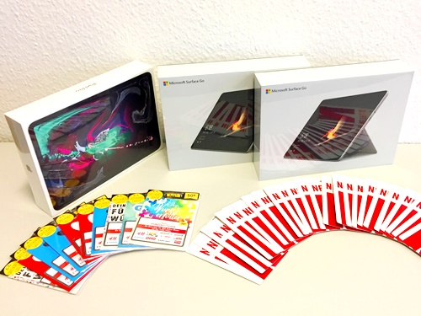
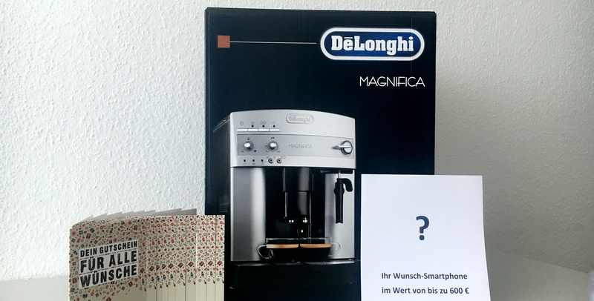
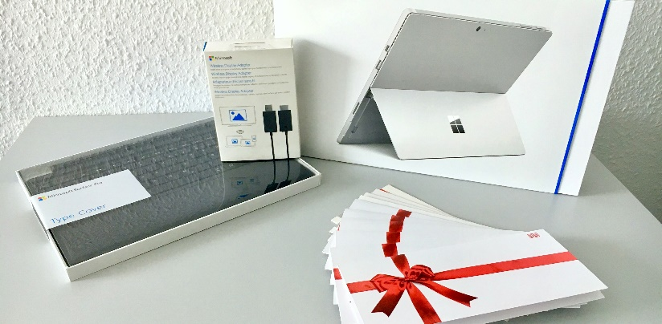
Participant Motivation and Incentivization
Prize draws
Raffles for larger high-value items or gift cards
Pros and Cons
Cost-effective, as not all participants receive reward
Generates fun and excitement
Reduces administrative burden
Uncertainty may reduce motivation
Communicate
Description of the prize(s)
Number of winners
Draw date and how winners will be contacted.
Best for
Large sample surveys
General or diverse populations
Limited budgets
German Centre for Higher Education Research and Science Studies. (n.d.). Incentive examples from the doctoral panel study (Promoviertenpanel). Retrieved July 9, 2025, from http://www.promoviertenpanel.de/meldungen
Notes:
Now let’s talk about prize draws . Prize draws involve offering participants the chance to win larger, high-value items or gift cards, rather than giving everyone a reward.
Here are some incentive examples for Nacaps raffles.
Let’s start with the pros and cons.
First off, it’s cost-effective. Not everyone gets a reward, which keeps your costs low while still making participation appealing.
It can generate a sense of fun and excitement, as participants anticipate the possibility of winning something valuable.
From an administrative perspective, it’s simpler—you don’t need to manage individual payouts for every participant.
But—and here’s the catch—the uncertainty of winning might actually discourage some participants, especially those who value guaranteed rewards over the thrill of a potential prize.
When is a prize draw the right choice?
It’s particularly well-suited for large sample surveys or when you’re working with diverse, general populations.
And if your budget is tight, this can be a great way to still provide an incentive without overspending.
What should you communicate?
Transparency is key! Clearly describe the prize or prizes participants could win.
State the number of winners—are there multiple chances to win or just one big prize?
And don’t forget to specify the draw date and exactly how winners will be contacted.

Slide 94


Participant Motivation and Incentivization
What works best according to research?
Offering instant compensation (e.g., cash, e-vouchers) upon survey completion outperforms delayed rewards in terms of response rates
Guaranteed small payments (e.g., 5€) generally motivate more people than the possibility of winning a larger prize (e.g., 100€).
As survey length increases, so should the value of the incentive
>
Amir (n. d.) Adobe Stock (Image ID: 569124). Retrieved July 9, 2025 from https://as1.ftcdn.net/v2/jpg/13/10/66/58/1000_F_1310665867_zkwsUk2wbWStVci4PmVooQf0e94YQ27X.jpg
Notes:
There is of course some evidence in survey research about what incentives work best.
instant compensation often outperforms delayed rewards when it comes to response rates. Imagine getting a small payment, like 5€, right after completing a survey –or even in advance. This certainty and immediacy are powerful motivators. People value a reward they can receive immediately over the possibility of something bigger later, like winning 100€ in a raffle.
And speaking of certainty, guaranteed small payments generally bring in more respondents than the potential of a larger prize.
One more thing to consider: the length of your survey. The longer the survey, the more valuable your incentive should be.

Slide 95
Exercise: Matching Incentivization Strategies to Target Groups
What incentive fits best?
Scenario 1: Graduate Student Research Study
A graduate student is conducting a survey for their thesis on study habits and time management among university students. They want to recruit as many students as possible across multiple universities and have a limited budget.
Raffle of small gift cards or vouchers
Scenario 2: Faculty Research on Collaborative Teaching
A team of researchers is studying interdisciplinary teaching practices and wants to survey faculty members from various disciplines. The survey is detailed and requires about 15 minutes to complete.
Survey results
Scenario 3: Public Health Survey on Vaccination Attitudes
A research team is conducting a survey to study attitudes toward vaccinations in a local community. The target audience includes parents of school-age children, and the survey is distributed online through schools and local health organizations. The survey takes approximately 10 minutes to complete.
Small toys or vouchers for toy stores; charitable donatiln to child welfare organization
Notes:
Let’s do a quick interactive exercise to wrap up our section on incentivization strategies.
I’ll show you a few short scenarios describing different survey contexts. For each one, I’d like you to think about what kind of incentive would be most appropriate — considering the target group, the topic, and any potential constraints like budget or time.
You don’t need to overthink it — just think practically: what would actually motivate people in that situation?
Let’s start with the first scenario…

Slide 96




Participant Motivation and Incentivization
What to consider in choosing an incentivization strategy?
Calculate the budget and decide whether broad incentives (e.g., micro-incentives) or selective incentives (e.g., prize draws) are more feasible.
Different groups respond differently to incentives:
Younger audiences may prefer digital rewards or price-draws for smartphones, laptops etc.
Professionals may value results
Choose incentives related to the survey topic to enhance perceived relevance.
Combine incentives (e.g. one large and few smaller prizes in a raffle)
Notes:
In the end, incentives are not a one-size-fits-all solution – they need to be tailored to your audience, your budget, and your survey goals.
First, let’s start with budget. Ask yourself: what can you realistically afford? If you’re working with a tight budget, micro-incentives – like small gift cards or small cash payments – can work wonders for larger, more diverse audiences. Alternatively, you might consider selective incentives, like prize draws, which reduce upfront costs but may appeal to fewer participants.
Next, think about who you’re targeting. Incentives that resonate with one group might not work with another. For instance:
Younger audiences tend to prefer digital rewards, like vouchers for apps, subscriptions, or even entry into a prize draw for a smartphone or laptop.
On the other hand, researchers might not care about gift cards as much, but they might value access to the survey’s results or other knowledge-based incentives.
It’s also crucial to choose incentives that align with your survey topic. For example, if you’re conducting research on health, offering fitness-related incentives like wearable devices or gym memberships can make the survey feel more relevant to participants. This relevance can boost motivation.
Finally, you can combine strategies. For instance, you could offer a raffle with one large prize – like a high-value gadget – but also include smaller prizes to keep more participants motivated.

Slide 97
Data Protection
Notes:
Alright, now we’re moving into a topic that’s not exactly a favorite among us survey researchers—data protection.

Slide 98
Data Protection
Why is it important to think about?
Designing surveys with data protection in mind helps ensure that all data collection processes are lawful, reducing the risk of penalties for non-compliance.
Compliant practices show respondents that their privacy is respected, which can lead to higher response rates and better-quality data.
Failure to comply with data protection regulations or poor implementation can negatively impact the research project (e.g., deletion of survey data)
Notes:
This is an area that might not seem as exciting as designing questionnaires or choosing an incentive strategy, but it’s crucial.
When it comes to data protection, it’s important to understand why this matters.
Firstly, Legal Compliance: We need to make sure our questionnaires meet data protection laws. This isn’t just a formality; non-compliance can lead to penalties, and we definitely want to avoid that.
Then there’s Building Trust: When respondents know that we’re taking their privacy seriously, they’re more likely to participate and be honest. This can lead to higher response rates and better data quality.
Finally, consider the Consequences for Your Project: If we overlook data protection regulations, it can have a direct impact on our research and in the worst case szenario, you need to delete the data before you had the opportunity to analyze it.

Slide 99

Data Protection
Disclaimer
NOT THE
I’m not a lawyer!
Meme using the "Surprised Koala" template. Caption via Imgflip.com. Retrieved June 30, 2025.
Notes:
Alright, quick disclaimer here! I am definitely not a lawyer, so I cannot give you legal advice on data protection or ethics!
Everything we’re talking about here is based on best practices and general guidelines, but if you're handling sensitive data or have questions about compliance, it’s always a good idea to consult with your institution’s legal or ethics department. They’ll have the specifics on what applies in your region and to your particular project. My goal here is just to sensitize you for these aspects! So, let’s dive into the basics, but remember: when in doubt, ask the experts!

Slide 100
Data Protection
EU’s General Data Protection Regulation (GDPR)
GDPR regulates how organizations process personal data.
deleting
web
cookies
address
transmitting
collecting
organizing
name
e-mail
telephone number
using
combining
recording
storing
Data
processing
gender
Personal data
restricting
erasing
income
health
disclosing
localisation
adapting
aligning
religious views
structuring
ethnicity
IP
cultural profile
altering
height
retrieving
Notes:
Alright, so here’s where GDPR, the General Data Protection Regulation, really comes into play, especially in survey research.
Since you’re collecting responses, you’re also gathering a lot of personal data—think names, contact info, sensitive information like health or income, and also paradata like the operating system, IP addresses and so on, depending on your survey.
GDPR regulates how all this information is processed, meaning anything you do with the data, from collecting and storing to analyzing and even erasing it, falls under these laws.

Slide 101








Data Protection
Sensitive personal data
Certain types of sensitive personal data are subject to additional protection under the GDPR (special category data according to Art 9 + 10 GDPR)
Ethnic origin
Religious or philosophical beliefs
Trade union membership and political opinions
Sex life or sexual orientation
Health information
Genetic and biometric data for identification
Crime records
flaticon.com
flaticon.com
Applies also to circumstantial personal information (e.g. name-specific data relating to the spouse, cohabitee or partner of a person) when it indirectly discloses the above mentioned information.
flaticon.com
Notes:
When it comes to survey research under GDPR, we have to be especially cautious with what’s known as 'sensitive personal data' or 'special category data.’
This includes information that could reveal a respondent’s ethnic origin, religious beliefs, political opinions, sexual orientation, health status, and even genetic or biometric data. Collecting this type of information means additional protections are required because it’s more vulnerable to misuse or discrimination.
Interestingly, GDPR also considers 'circumstantial' personal information as sensitive if it indirectly reveals any of these categories. So, for instance, if a question indirectly discloses sexual orientation through relationship details or household structure, we need to treat it with the same level of caution. For any survey involving these sensitive data points, it’s essential to assess the necessity of each question and apply strict data protection measures to ensure compliance and build participant trust.

Slide 102





Data Protection
Legal basis for data processing
Legislation
There is a statutory provision that permits (or mandates) data processing
Consent
The individual has given clear consent for their data to be processed for a specific purpose
Notes:
In survey research, having a clear legal basis for processing data is essential under GDPR. There are two main ways we can justify data processing here:
Legislation - In some cases, there may be statutory provisions that require or permit data processing for specific purposes, such as certain types of public research. This doesn’t typically apply to most survey research but is important in certain contexts.
Consent - This is the most common basis we rely on in survey research. We ask participants to give their informed consent, which means they agree to the specific use of their data for our research. This consent needs to be clear, specific, and freely given.

Slide 103
Data Protection
GDPR Principles in Data Processing
Accountability
Lawfulness
Fairness
Transparency
Security
Integrity
Confidentiality
Purpose
Limitation
Storage Limitation
Data Minimization
Accuracy
Notes:
There are seven core principles in the GDPR. Let’s break down how these GDPR principles apply specifically to web survey design.
1. Lawfulness, Fairness, and Transparency:
The foundation of GDPR. You need a clear legal reason to process data – in our case, it is mostly consent.
Fairness means treating people’s data with respect, and transparency is about being upfront – people should know how and why their data is being used.
2. Purpose Limitation:
Data collection needs a focus. You can’t collect data 'just in case' you need it later. Make sure you define the purpose up front and stick to it.
3. Data Minimisation:
Only collect the data you absolutely need – nothing more. Less data means less risk, and it’s better for everyone involved.
4. Accuracy:
Data should be correct and current. Mistakes here can lead to all kinds of problems, from skewed results to loss of trust.
Always validate and update data where possible.
5. Storage Limitation:
Don’t hold onto data forever. Keep it only as long as it’s necessary for your project or legal requirements. This also ties back to minimisation – if you don’t have it, you don’t have to secure or worry about it.
6. Security, Integrity, and Confidentiality:
Protect data. This means good technical security measures and also robust policies. Think about who has access, how it’s shared, and how breaches can be prevented.
7. Accountability:
This is where you show your work – document your processes, your safeguards, and your compliance. It’s about being able to say, 'We’re handling this data properly, and here’s how we’re doing it.

Slide 104
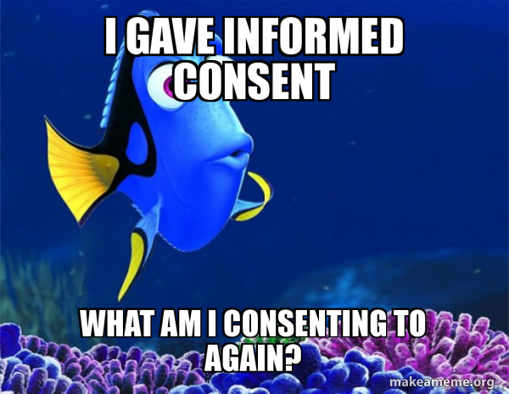
Data Protection
Informed consent
Information for data subjects about data processing (Art. 13, 14 GDPR)
Responsible entity (name and contact details) / contact details of the data protection officer
What categories of personal data are being processed?
For what purpose is the data being processed?
On what legal basis is the data processing taking place?
Which groups of recipients have access to the data?
When will the data be deleted or anonymized?
If applicable, information on data transfer outside the EU
Information on data subjects' rights under GDPR (access, deletion, etc.)
Unknown creator (n.d.). I gave informed consent, but I didn’t understand a thing [Meme]. Retrieved June 30, 2025, from https://makeameme.org/meme/i-gave-informed
Notes:
Informed consent is essential under GDPR to make sure respondents know exactly what they’re agreeing to when they participate in our surveys. Here's what we need to communicate:
Who’s Responsible – Provide the name and contact details of the entity conducting the survey, as well as the contact details for the data protection officer.
Data Categories – Clearly outline which types of personal data will be collected and processed.
Purpose – Explain why we’re collecting this data. What’s the specific purpose behind each piece of information?
Legal Basis – Let participants know the legal grounds for data processing, whether it's consent, legal obligation, or another basis.
Access – Identify who will have access to the data. This could include specific departments or external parties if relevant.
Data Retention – Tell participants how long their data will be kept and when it will be deleted or anonymized.
Data Transfer – If data will be transferred outside the EU, inform participants, as this involves additional GDPR requirements.
Rights – Participants should understand their rights, like the ability to access, correct, or request deletion of their data.

Slide 105

Data Protection
Informed
Consent
- Example
German Centre for Higher Education Research and Science Studies (2024). National Academics Panel Study (Nacaps) 2018 - Survey 2. Data collection: 2020. Hanover: FDZ-DZHW. https://doi.org/10.21249/ DZHW:nac2018:2.0.0. Questionnaire "Nacaps 2018. Variable Questionnaire for National Academics Panel Study 2018 (2nd wave - doctoral candidates) (English) ". Index page.
German Centre for Higher Education Research and Science Studies (2024). National Academics Panel Study (Nacaps) 2018 - Survey 4. Data collection: 2022. Hanover: FDZ-DZHW. https://doi.org/10.21249/DZHW:nac2018:2.0.0. Questionnaire "Nacaps 2018. Information and Consent to Survey and Data Protection
Notes:
Let's take a closer look at how informed consent is handled here using two examples from the survey.
First, on the left, we have the main survey introduction page. This is the initial point where respondents are introduced to the study. It gives them a summary of what the survey is about, and there’s a clear checkbox where participants must confirm they've read and agreed to the data protection statement. This checkbox is essential because, without this consent, respondents can't proceed with the survey. It makes sure participation is truly voluntary and informed from the very start.
Now, on the right, we have the linked 'Datenschutzblatt' or data protection sheet. This document goes into much more detail. It outlines exactly what types of data will be collected, how that data will be used, and the respondent's rights under GDPR. It also provides contact information for the data protection officer, allowing participants to reach out if they have specific concerns or questions about data privacy.
Together, these two elements – the consent checkbox on the main survey page and the detailed information in the linked document – ensure that respondents are fully informed and have the opportunity to understand exactly how their data will be handled, and you are on the safe side here.

Slide 106














Data Protection
Third-Party Platforms
Online surveys must protect respondents' data, especially when collecting personal or sensitive information.
Ensure that the survey platform uses encryption (e.g., SSL) to secure data transmission.
Survey platform needs to comply with data protection regulations (e.g. GDPR, HIPAA)
store data on EU servers
(EU server for new corporate customers only)
(intransparent about server locations)
(enterprise version of Google Workspace and have set your data storage preferences )
Notes:
Let’s talk about selecting the right platform for your web surveys. This isn’t about features or cost—it’s just about data protection and trust.
With online surveys, we’re often collecting sensitive or personal information. That means we need to be very careful about which tools we use.
1. Encryption is Non-Negotiable:
The platform must use encryption, such as SSL, to secure data transmission. When participants submit their responses, they need to know their data won’t be intercepted or misused.
2. Compliance with Data Protection Laws
Platforms should comply with relevant regulations, like GDPR for EU-based projects. Compliance ensures that your participants’ rights are protected and that you’re legally covered.
3. Data Storage on EU Servers:
For those of us working with data from people inside the EU, you need to check the storing of data. Storing data on EU-based servers ensures compliance with GDPR and avoids concerns about international data transfers. This is especially important if you’re using platforms that might host data elsewhere by default.
I did some quick research about the data security measures of the most commonly used survey platforms.
Klick
Green smiley platforms, like LimeSurvey, REDCap, and Unipark, are generally safe bets. They are GDPR compliant and store data on EU servers. The university of Bremen sadly doesn’t provide any LimeSurvey licenses. The Hochschule does, but the University recommends to use EUSurvey instead. I don’t have personal experiences in doing surveys with EUSurvey, but I already came across plenty of researchers who use this.
Platforms like SurveyMonkey and Qualtrics are mixed bags. SurveyMonkey is okay if you’re on a corporate account. In this case, you can opt for EU servers, but just for new customers. Qualtrics, is super intransparent about server locations on their website. They apparently run servers in different parts of the world, but there is no information about if and how you can chose a location within EU. For Google Forms, you need to have an enterprise version and manually need to set your data storage preferences to the EU.
Then there is Typeform, which store data on Amazon servers in the US only.

Slide 107

Data Protection
Collecting Contact Information in Web Surveys
Inquire contact data at the end of the survey
Allow participants to opt out
Clearly separate survey data from contact data
Use dedicated tools or functions to collect contact information For example, use a "contact form" function or linked survey page that stores data on a separate server.
Store contact data separately from response data
Apply strong encryption
Use secure and access-controlled storage
Store on institutional servers or trusted, GDPR-compliant cloud solutions.
Restrict access to contact data
Grant access only to authorized personnel, ideally with role-based permissions.
Inform participants transparently
Clearly state what data will be collected, how it will be stored, and for what purpose.
Cryptomator - Installation
Notes:
So, let’s talk about what to keep in mind when we ask participants for their contact information in a web survey. This might be for follow-up surveys, incentives, or sending results.
First, I recommend to ask for contact information at the end of your survey. In case this scares them, the at least didn’t drop out in the beginning of your survey.
And always let them opt out
First, it’s really important to separate the contact data from the survey responses. Ideally, we want no direct link between what someone said in the survey and their name or email.
Most survey tools have special features for this—like a contact form that’s stored on a different server, or a redirect to a second, separate survey just for the contact info. It’s a good idea to use those instead of collecting everything in one place.
Next, make sure the contact data is stored separately from the response data. That can mean two files, two databases, or even two servers. And of course, use strong encryption—both while the data is being transmitted and when it’s stored.
It’s also essential to store the contact data on a secure system—preferably on an institutional server or a cloud service that meets data protection standards like GDPR.
Access to that data should be strictly limited—only people who really need it should be able to see it.
And let participants know what’s happening. Be transparent about why you’re collecting contact information, how you’ll protect it, and how long you’ll keep it.
Finally, always give participants the option to say no. They shouldn’t feel forced to leave their contact info. And make sure you have a plan to delete the data when it’s no longer needed.

Slide 108

Data Protection
Ressources
U Bremen employees
Katja Losch-Kremer
katja.losch-kremer@vw.uni-Bremen.de
Consulting on Data Protection
Data Protection Officer
Information portal on data protection and information security
Templates
Checklist “Data Protection for Research Projects” (DE/EN)
… and More
RatSWD Data Protection Guide
RatSWD Informed Consent Documents
VerbundFDB Information and Templates (also for minors)
BERD@BW Virtual Assistant Tool
Notes:
Here is a helpful collection of resources for data protection, especially relevant for those at the University of Bremen and researchers working on data-intensive projects.
For University of Bremen employees, Katja Losch-Kremer is available as the Data Protection Officer, offering consulting on data protection rights. Her contact details are provided, so feel free to reach out if you need guidance on specific issues.
Beyond individual consulting, there’s an information portal on data protection and information security, which includes templates and a checklist for data protection in research projects, available in both German and English.
For more general resources, the RatSWD Data Protection Guide and Informed Consent Documents are excellent starting points. Additionally, the VerbundFDB offers information and templates, even covering research with minors, and the BERD@BW Virtual Assistant Tool provides further support.

Slide 109
Break

Slide 110
Documentation
Notes:
As the final topic in this workshop, I would like to discuss the documentation of the questionnaire.

Slide 111

Documentation
Why is it important to think about it?
Allows others (e.g., collaborators, reviewers, or stakeholders) for future you to understand the rationale behind design choices and changes
Tracks changes and secures against data loss
Provides context for interpreting results accurately
Enables researchers to assess what worked well and consider alternative approaches for future projects
Provides the necessary details that reviewers and funders look for when evaluating the study
Documents compliance with data protection laws (like GDPR) and ethical considerations
Provides information and material for publishing and reusing the data
Drata. (2023). “I was told there would be documentation” meme. Retrieved June 30, 2025, from https://drata.com/blog/compliance-memes
Notes:
Here’s why documentation is essential.
It allows collaborators, reviewers, and stakeholders, as well as your future self, to understand the reasons behind design choices and any modifications made.
It also helps track changes and prevent data loss.
It provides the context needed for accurately interpreting results.
Documentation supports the assessment of what worked well and what could be improved, which is crucial for future projects.
Reviewers and funders also expect detailed documentation to evaluate your study.
Documentation also helps you to prove your study’s compliance with data protection laws like GDPR and ethical standards.
Lastly, it provides necessary information for publishing and potentially reusing the data in other research.

Slide 112

Documentation
What to document?
General information
Study topic and objectives
Researchers and affiliations
Funding
Responsibilities
Fieldwork time
Target population
Sampling strategy
Sample size, characteristics
Response metrics
Notes:
First, there are a couple of general information you need to write down.
Study Topic and Objectives: Clearly outline the goals of your study. Why are you conducting this survey, and what do you hope to learn? This sets the foundation for everything else.
Researchers and Affiliations: Document the names and affiliations of all involved researchers. This ensures proper attribution and helps contextualize the study’s scope and credibility.
Funding: Note who’s funding the project and the terms of that funding. Transparency here builds trust and can highlight potential conflicts of interest.
Responsibilities: Define who is responsible for what. Whether it’s data collection, analysis, or communication, everyone should know their role.
Fieldwork Time: Record the timeline of the data collection phase. This is particularly important for monitoring response rates and ensuring timely completion.
Target Population: Specify who you’re targeting. Are you surveying students, professionals, or another specific group? This helps in interpreting the results later.
Sampling Strategy: Clearly describe your approach—random sampling, quota sampling, or otherwise. It’s crucial for understanding the representativeness of your data.
Sample Size and Characteristics: Document your expected and achieved sample sizes, as well as any key demographics. This is especially useful for checking generalizability.
Response Metrics: Include response rates, dropout rates, and any other relevant metrics. These provide insights into the survey’s success and data quality.
Most of the information here are self-explanatory, but I want to address some aspects a little bit more in detail.

Slide 113

Documentation
Response metrics
The American Association for Public Opinion Research (AAPOR) provides standardized definitions and formulas for response metrics
ensures consistency, transparency, and comparability in reporting survey outcomes.
AAPOR Standard Definitions Final Dispositions of Case Codes and Outcome Rates for Surveys
AAPOR Response Rates Calculator
Briedis, K., Lietz, A., Ruß, U., Schwabe, U., Seifert, M., Mühleck, K., Scheller, P., Teichmann, C., de Vogel, S., Weber, A., Schmidtchen, H., Birkelbach, R., Hoffstätter, U. & Oestreich, T. (2024). Nacaps 2018 - Data and methods report on the National Academics Panel Study 2018 (1st-4th wave - doctoral candidates). Hanover: RDC-DZHW.
Gesis Adaptation of the AAPOR Final Disposition Codes for the German Survey Context
Notes:
First, I want to talk about response metrics—a crucial part of evaluating and reporting survey performance.
The American Association for Public Opinion Research (AAPOR) has developed a standard framework for calculating and reporting response metrics. These are commonly used in the social sciences to evaluate surveys. This makes survey metrics standardized, assessable, and comparable. If you later plan to publish a paper using this data, write a report for your funders, or release the data, you will need to use the AAPOR methodology.
Here’s an example of how such a calculation can look, using the Nacaps survey as a reference.
I’ve linked the AAPOR guidelines for you, a tool for the calculations, and an adaptation of the AAPOR guidelines for Germany provided by GESIS.

Slide 114


Documentation
What to document?
General information
Questionnaire
Study topic and objectives
Researchers and affiliations
Funding
Responsibilities
Fieldwork time
Target population
Sampling strategy
Sample size, characteristics
Response metrics
Measurement instrument development
Translation
Pretests (interview guide-lines, transcripts, results)
Variable questionnaire, Layout version (e.g. screenshots)
Flowchart
Codebook
Notes:
Now let’s focus on the questionnaire itself—arguably the heart of any survey. Here’s what to include:
Measurement Instrument Development: Document how the questionnaire was developed. Was it adapted from existing validated instruments, or created from scratch? Include any theoretical frameworks or guidelines that influenced the questions.
Translation: If your survey is multilingual, detail how the translations were done. Did you use back-translation or cultural adaptation techniques?
Pretests: Pretesting is a key step. Document how you tested the questions—whether through cognitive interviews, pilot studies, or focus groups. Include guidelines, transcripts, and results.
Variable Questionnaire and Layout Versioning: Keep records of all versions of the questionnaire, including layout changes. Screenshots are helpful for documenting what respondents actually saw, especially for web surveys.
Flowchart: Create a flowchart showing the structure of your questionnaire. It should map out the branching logic—where respondents skip questions based on their previous answers. This is especially critical for complex, adaptive surveys.
Codebook: Finally, you need a detailed codebook. I will explain what that is in a minute.

Slide 115


Documentation
Variable questionnaire and layout version
German Centre for Higher Education Research and Science Studies (2024). National Academics Panel Study (Nacaps) 2018 - Survey 1. Data collection: 2019. Hanover: FDZ-DZHW. https://doi.org/10.21249/DZHW:nac2018:2.0.0. Questionnaire "Nacaps 2018. Variable Questionnaire for National Academics Panel Study 2018 (1st wave - doctoral candidates) (English) ". Question A05.
Notes:
In this example, we see the same question documented in two different ways. On the left, we have the variable questionnaire, which lists each variable name and the corresponding value codes for the question. This is essential for data processing and analysis, as it provides a clear reference for each response option. We see also information on the visible conditions and the outlet filter.
On the right, we have the layout questionnaire, where the question is presented as the participant would see it during the survey. Documenting this is important because, as I've mentioned before, the layout of a question can influence response behavior. By keeping a detailed record of the layout, we can better understand any potential impact the presentation might have had on how participants answered.

Slide 116




Documentation
Flowchart
Visual tool that maps out the structure and logical flow of the survey
Sequence of questions
Skip patterns or branching logic
Visible condition
Randomization and rotation
German Centre for Higher Education Research and Science Studies (2024). DZHW PhD Panel 2014 - Survey 1. Data collection: 2015. Hanover: FDZ-DZHW.10.21249/DZHW:phd2014:4.0.0. Question Flow (5th wave - German)
Notes:
Flowcharts are essential tools in survey design, especially for complex questionnaires. They visually map out the structure and logical flow, showing the order of questions, skip patterns, and branching logic, or visible conditions.
Additionally, if your survey includes randomization (for example, rotating the order of answer options to reduce response bias), the flowchart should document this.
For online surveys, most survey platforms allow you to automatically generate the flowchart.
Such a flowchart is also important for data processing, as it allows you to check afterward whether the filtering logic worked correctly.

Slide 117

Documentation
Codebooks
Structured document that provides detailed information about the variables and coding system used in a dataset:
Variable name, -label, -type
Valid values, value labels
Missing values
More Infos
Cookbook for a Codebook
Cernat, A. (n.d.). An easy way to make a codebook in R. Retrieved June 30, 2025, from https://www.alexcernat.com/easy-way-to-make-a-codebook-in-r/
DDI Codebook
Examples of DDI codebooks
There are also R-packages, for example, that can be helpful in the automatic creation of DDI codebooks (DDIwR, rddi)
Some survey platforms generate codebooks automatically
Based on Dörfel, D., et al.. (2023). Der Datenmanagementplan. Eine praktische Einführung in das Forschungsdatenmanagement deines Projektes. Workshop auf der 48. Jahrestagung Psychologie & Gehirn an der TU Dresden.
Notes:
Finally a codebook is an essential part of documentation in survey research, as it provides detailed information about each variable in a data file. It’s crucial for future you and other researchers to understand, interpret, and even reuse the data collected. For instance, the codebook records each variable’s name, label, type, valid values, and what those values mean, making it easy to interpret each data point without guessing or misinterpreting. Additional details might also capture specific item formulations, related instruments, or units of measurement. This is especially valuable when time has passed, and you or others are less familiar with the specific details of the survey.
I've linked various resources here. I particularly recommend the DDI Guidelines for creating a codebook and the corresponding examples. DDI is the standard for metadata — that is, data that describes your data — in the social and economic sciences. There are now also R scripts available that allow you to automatically generate DDI codebooks.
But the most, or at least some, survey platforms also generate codebooks automatically.

Slide 118


Documentation
What to document?
General information
Questionnaire
Data collection
Study topic and objectives
Researchers and affiliations
Funding
Responsibilities
Fieldwork time
Target population
Sampling strategy
Sample size, characteristics
Response metrics
Measurement instrument development
Translation
Pretests (interview guide-lines, transcripts, results)
Variable questionnaire, Layout version (e.g. screenshots)
Flowchart
Codebook
Contact strategy
Reminder strategy
Invitation and reminder letters
Incentives
Informed consent, checklists
Notes:
Let’s zoom in on the Data Collection section. Here’s what you need to document carefully:
Contact Strategy: First, think about how you'll reach your target group. Are you emailing, or using social media? Document your plans so it’s clear and repeatable for others or for future studies.
Reminder Strategy: Plan and note when you sent them, how many you sent, and what they said.
Invitation and Reminder Letters: Speaking of messaging, keep a record of every version of your emails or letters.
Incentives: If you’re offering rewards, whether it’s cash, gift cards, or prize draws, clearly document the details. This includes what you’re offering, how participants will get it, and when.
Informed Consent and Checklists: Finally, keep a version of the informed consent and the checklists on data protection you hopefully are going to use for your survey.

Slide 119

Documentation
Version control
Records changes made in a file or set of files over time, so that you and your collaborators
can track their history
review any changes
revert or go back to earlier versions
How?
Use continuous numbering
Include date and version number in the file names
Use a version control table
Save versions of milestones
version control software (e. g. Git and Github)
ELIXIR Belgium (n. d). Version control table. Retrieved June 30, 2025, from https://rdm.elixir-belgium.org/version_control
Based on Biernacka., K. et al. (2023). Train-the-Trainer-Konzept zum Thema Forschungsdatenmanagement (Version 5). doi: 10.5281/zenodo.1215376
Notes:
For all these documents, you should maintain some form of version control from the very beginning of the survey development process. Version control is important for tracking changes over time in any document or project file.
It allows us to keep a detailed record of every modification made, along with the date and the author responsible for the change. If there was a mistake in filtering, or you deleted a question and later you change your mind and want to include this question into your questionnaire again, version control enables us to go back to a previous version easily.
For practical implementation:
Use continuous numbering to maintain version consistency.
Include the date and version number in file names.
A version control table like the one shown can help keep track of status, changes, and approvals.
Saving milestone versions is also critical, especially for larger projects.
At the beginning, we designed our surveys in the project the old-school way, using Word. We documented changes by tracking revisions in edit mode and saving updated versions with version numbers and dates.
However, over time, we realized that this method was very cumbersome and prone to errors, especially when adding complex filter conditions that sometimes didn’t work during testing. In such cases, it became crucial to have a robust version control system to help identify where a mistake might have been made. We then switched to using Git. Collaboration with others was managed through GitHub, and this approach proved to be really effective. So I can really recommend using Git for this.

Slide 120

Documentation
Example: Nacaps
Nacaps metadata
German Centre for Higher Education Research and Science Studies (DZHW). (n.d.). National Academics Panel Study (Nacaps), 2018 – Version 2.0.0. FDZ-DZHW Metadata Portal.
Retrieved June 25, 2025, from https://metadata.fdz.dzhw.eu/de/data-packages/stu-nac2018?page=1&size=10&type=surveys&version=2.0.0
Notes:
As an example, I want to quickly show you these types of documents related to the Nacaps study I published in a repository for higher education and science research data.

Slide 121



Documentation
Guidelines
Gesis Guidelines on Documentation of Online Surveys
Gesis Guideline on Survey Data Documentation
AAPOR Best Practices for Survey Research
Gesis Guideline Documenting Measurement Instruments for the Social and Behavioral Sciences
RatSWD Guidelines on Quality Standards for Measurement Instruments
Gesis Guideline on Documenting Survey Translation
Notes:
I’ve put together a few guidelines for documenting surveys, most of which are from GESIS.

Slide 122
Getting Started
Notes:
So how to get started with designing your web survey?

Slide 123
Getting Started
Recommended order
Develop your research question and hypotheses
Define the target population
Choose a sampling strategy
Decide on a recruiting and incentivization strategy
Develop a public relation strategy
If necessary, decide on a web survey platform
Develop, pretest, revise and finish the questionnaire
Implement the questionnaire
Test and revise the implemented questionnaire
Draw your sample
Craft invitation letter and reminder
Survey start
Proposal phase
Preparation phase
Field phase
Notes:
When starting a survey project, it’s helpful to follow a structured approach. Here’s a suggested order of tasks to get you moving forward smoothly and give you an idea on how to get started with your survey.
Clarify your research question and hypotheses: Think about what you really want to find out. A clear focus will make every other decision easier and keep your project on track.
Define your target population: Who needs to answer your survey? Be specific about their characteristics and accessibility, as this will affect recruitment efforts and costs.
Choose your sampling strategy: Decide how you’ll select participants to ensure your results are meaningful and representative of your target group.
Plan your recruitment and incentivization strategy: Consider how you’ll motivate people to participate. Will you offer monetary rewards, access to results, or something else? This can significantly impact response rates and budgets.
Think about public relations (if relevant): If your survey has a broader audience, you might want to invest in setting up a nice project website or social media account.
Decide on your survey platform: The platform you choose impacts not just usability but also data security, functionality, and costs. Make sure to consider these factors early on.
This were a lot of critical decisions already. And it’s best to consider this already in your proposal phase.
Klick
These choices directly impact how much time, money, and effort will be needed later. Investing time in the proposal phase will save you headaches down the line and ensure your survey is both feasible and effective.
Develop your questionnaire: This includes writing the questions, testing them to ensure they’re clear, and revising based on feedback. Pretesting is especially crucial to avoid surprises later.
Set up and test your survey: Implement your questionnaire on the platform and test it thoroughly. Pay attention to usability, logic, and technical issues.
Plan your sample and timeline: Identify the people you’ll contact and map out a realistic timeline for invitations, reminders, and data collection.
Prepare invitations and reminders: Craft compelling communication materials that explain why participation matters, emphasize confidentiality, and provide clear instructions.
Launch your survey: Start data collection and monitor responses to ensure everything runs smoothly.
This list isn’t exhaustive, but it gives you a strong starting point. Remember, planning carefully now will make the rest of the process much easier!

Slide 124
Wrap Up
Notes:
We are now at the end of our workshop and I want to make a quick wrap up.

Slide 125
Resources
Data Quality
Groves, R.; Fowler, F.; Couper, M.; Lepkowski, J.; Singer, E.; Tourangeau, R. (2009). Survey Methodology (2nd Edition). John Wiley & Sons, Inc. ISBN 0-470-46546-8
Danner, D. (2016). Reliability – The precision of a measurement. GESIS Survey Guidelines. Mannheim,
Germany: GESIS – Leibniz Institute for the Social Sciences. doi: 10.15465/gesis-sg_en_011
Repke, Lydia; Birkenmaier, Lukas; Lechner, Clemens M. (2024). Validity in Survey Research -
From Research Design to Measurement Instruments. Mannheim, GESIS – Leibniz-Institute for
the Social Sciences (GESIS – Survey Guidelines). DOI: 10.15465/gesis-sg_en_048
Web Surveys
Bandilla, W. (2016). Web Surveys. GESIS Survey Guidelines. Mannheim, Germany: GESIS – Leibniz
Institute for the Social Sciences. doi: 10.15465/gesis-sg_en_003
Beuthner, C., Daikeler, J., & Silber, H. (2019). Mixed-Device and Mobile Web Surveys. Mannheim, GESIS -
Leibniz-Institute for the Social Sciences (GESIS - Survey Guidelines).
DOI: 10.15465/gesis-sg_en_028
Notes:
First of all, I want to provide you with further resources and I’ve put together a list of useful literature on the topic of web survey design for you. Mostly, these are very cool guidelines from GESIS that can help you with practical application.

Slide 126
Resources
Sampling
Gabler, S., & Häder, S. (2016). Sampling in Theory. GESIS Survey Guidelines. Mannheim, Germany: GESIS
– Leibniz Institute for the Social Sciences. doi: 10.15465/gesis-sg_en_009
Häder, S. (2016). Sampling in Practice. GESIS Survey Guidelines. Mannheim, Germany: GESIS – Leibniz
Institute for the Social Sciences. doi: 10.15465/gesis-sg_en_014
Pötzschke, Steffen, Weiß, Bernd, Daikeler, Jessica, Silber Henning and Beuthner, Christoph (2023). A
guideline on how to recruit respondents for online surveys using Facebook and Instagram: Using hard-toreach health workers as an example. Mannheim, GESIS – Leibniz Institute for the Social Sciences (GESISSurvey Guidelines). DOI: 10.15465/gesis-sg_en_045
Nonresponse-Bias
Koch, A., & Blohm, M. (2016). Nonresponse Bias. GESIS Survey Guidelines. Mannheim, Germany: GESIS –
Leibniz Institute for the Social Sciences. doi: 10.15465/gesis-sg_en_004
Barbara Felderer (2024). Nonresponse Bias Analysis. Mannheim, GESIS - Leibniz Institute for the Social Sciences (GESIS- Survey Guidelines). DOI: 10.15465/gesis-sg_en_047
126

Slide 127
Resources
Data Collection and Fieldwork
Stadtmüller, S., Martin, S., & Zabal, A. (2019). Das Zielpersonen-Anschreiben in sozialwissenschalichen Befragungen. Mannheim, GESIS - Leibniz Institute for the Social Sciences (GESIS - Survey Guidelines). DOI: 10.15465/gesis-sg_029
Pforr, K. (2016). Incentives. GESIS Survey Guidelines. Mannheim, Germany: GESIS – Leibniz Institute for
the Social Sciences. doi: 10.15465/gesis-sg_en_001
Para Data
Kunz, T. & Hadler, P. (2020). Web Paradata in Survey Research. Mannheim, GESIS - Leibniz Institute for the Social Sciences (GESIS - Survey Guidelines). DOI: 10.15465/gesis-sg_037
Kunz, Tanja, Christoph Beuthner, Patricia Hadler, Joss Roßmann, and Ines Schaurer (2020). Informing
about Web Paradata Collection and Use. Mannheim, GESIS - Leibniz Institute for the Social Sciences
(GESIS - Survey Guidelines).
127

Slide 128


Resources
Gesis Survey Methodology Consulting
Target audience
Researchers planning a social science survey
Not for final theses
Costs
Help to help yourself is free
Charges apply for more in-depth services
GESIS – Leibniz Institute for the Social Sciences. (2025). Survey Methods Consulting. Retrieved June 30, 2025, from https://www.gesis.org/en/consulting/survey-methods-consulting
More information… Gesis Website
Notes:
So, here’s a great resource for anyone working on social sciences surveys: GESIS offers survey methodology consulting.
They provide tailored advice on study planning, data collection, survey design, pretesting, questionnaire design and so on. The consulting is free when it’s in the form of 'help to self-help.
In our project, we reached out to GESIS several times to have them look over our questionnaires, and it was super helpful. For more complex or in-depth services, though, they do have fees. So, it’s worth looking into what they can offer depending on where you are in your survey development process.

Slide 129


Resources
Gesis Training
What they offer
Workshops (Cologne/Mannheim/Online)
Summer School in Survey Methodology
Spring Seminar
Pro‘s and Cons
They are great!
ECTS points
International audience
Costly
More information… Gesis Training Website
GESIS – Leibniz-Institute for the Social Sciences (2025). GESIS Training – Workshops and Courses. Retrieved May 19, 2025, from https://training.gesis.org/?site=pOverview&cat=all
Notes:
Another resource I highly recommend is GESIS Training. They offer a range of survey design related courses, from workshops to full programs like their Summer School in Survey Methodology and Spring Seminar. These trainings are available in Cologne, Mannheim, or online, so there’s flexibility in terms of location.
One of the best things about these trainings is that they’re very high-quality. Plus, many of them offer ECTS points, which is great if you're looking to earn credits. They also draw an international audience, which makes for a really fun learning environment. I always felt like doing Erasmus student exchange there. But, they can be a bit pricey. But if it fits in your budget or you have funding, it’s definitely worth it.
You can find more information and see their schedule on the GESIS Training website.

Slide 130
DataNord Trainings & Workshops
Simplifying Data Science with Galaxy: A Beginner’s Workshop
20.05.
Interdisciplinary and subject-specific workshops (esp. in social sciences, marine and environmental sciences, health sciences, and humanities)
On-demand customized training for graduate programs, departments, etc.
Good Planning, Better Survey Data – Introduction to Web Survey Design
02.06.
Data Collection Made Easy – Implementing Web Surveys with EUSurvey
16.-17.06.
24.06.
Python Quickstart for Quantitative Data
… more on dsc-ub.de/en/qualification
From Data Chaos to Clarity: Essential Strategies for Research Data Management in Qualitative Research
25.06.
Applied Text Mining Using Python
14-17.07.
And many more…
Notes:
This was one workshop in a series of trainings we as the Data Science Center are offering on data science and data management related topics. Some are discipline specific, but many are interdisciplinary. They are all free of charge. You can find more information about the courses and how to register on our website.

Slide 131


„Data Snacks“
Data Insights in 30 Minutes!
Short and engaging sessions on different “data topics”
Next Data Snack Series: May to June 2025
Free & open for everyone
Online
No registration required, just drop in!
More information at:
https://www.dsc-ub.de/data_science_forum.php
Notes:
Our Data Snacks are 30-minute sessions with quick, practical insights into data. The next series is in May and June 2025, covering everything from FAIR management to text mining and large language models. It’s a light format, it’s online and there is no need to register. Just drop by!

Slide 132






DataNord Consulting Service
Resources
Lisa Jungmann, U Bremen
How do I prepare my data to apply machine learning?
Interdisciplinary Help Desk for researchers from all DataNord institutions
Support in the application phase and research process
Free of charge!
More information: https://dsc-ub.de/en/consultation.php
How can I create a data management plan?
What do I need to consider when collecting social media data?
Notes:
Additionally, as part of our DataNord project, we at the Data Science Center at the university of Bremen have a dedicated consulting service for data science and data management inquiries to support all processes throughout the data lifecycle.
We are an interdisciplinary team of five data scientists from statistics, environmental sciences, marine sciences and humanities, and our job is to assist you with everything from data collection and cleaning to analysis, visualization, and interpretation. So even if you have some subject specific problems, we are happy to help or can at least try to connect you with someone who can.
Because this is just an introductory training on questionnaire design and there is not much space here to discuss your specific needs or problems, you are always welcome to contact me to discuss your questionnaires or survey research design in a one-on-one meeting.
You can contact us simply via our consultation website. There, you can find our contact information or if you don‘t have a specific person in mind who may help you, you can simply write to our team address.

Slide 133

DataNord Newsletter
Sign Up Now!
Monthly Updates!
Target group: Researchers and anyone who is interested in our offers
Overview of DataNord trainings, networking opportunities and other events in the next month
Additional announcements
www.bremen-research.de/ datanord/newsletter
133
Notes:
If you want to stay up-to-date about our activities at the DSC, sign up for our DataNord newsletter!

Slide 134


Evaluation
Meme using an image of a baby pygmy hippopotamus. Original photo source unknown; Caption created via Imgflip (Retrieved June 30, 2025)
9GAG (via Pinterest). (n.d.). “If you need inspiration on your teacher evaluations…” Retrieved June 30, 2025, from https://de.pinterest.com/pin/448460075368152788/
Notes:
One thing before you all leave – we prepared an evaluation form for our workshops. This is the link and I would be very happy if you can take three minutes to fill it out. Your feedback would be super helpful to improve our workshops in the future.

Slide 135

Thank You for Your Participation!
CONTACT
Dr. Susanne de Vogel
Data Scientist | Help-desk
devogel@uni-bremen.de
dsc-ub.de
135
Notes:
So, I now arrived at the end of the workshop. Thank you very much for your attention and I hope, you found it helpful.

Slide 136


License and third-party content
This OER is licensed under Creative Commons Attribution 4.0 International (CC BY 4.0) unless otherwise noted.
You are free to: – Share — copy and redistribute the material in any medium or format – Adapt — remix, transform, and build upon the material as long as you give appropriate credit.
Third-party content such as images, memes, comics, or screenshots is not covered by the CC license of this presentation.
These items are used for non-commercial educational purpose with explicit attribution. For reuse or publication of this material, please ensure to check the license status of each individual item.

